Slide 1

Theory of Computation
Theory of Computation (TOC)
DU # 2101CS603
Prof. Dixita B. Kagathara
Computer Engineering Department
dixita.kagathara@darshan.ac.in
+91 - 97277 47317 (CSE Department)

Slide 2
Why & What TOC is???

Slide 3
TOC
Any task that can be performed by machine

Slide 4

Introduction
TOC tries to give answer of following questions:
What are the mathematical properties of computer Hardware and Software?
What are the Capabilities and Limitations of computer?
Can everything be computed?

Slide 5
Introduction
Our main purpose is to determine:
What can and can’t be computed?
How quickly?
With how much memory?
On which type of computational model?
Can we solve following problem?
Yes (Accept)
Accepts all binary strings ends with 0
Input
Think
Accepts all valid C code
No (Reject)
Accepts all valid C code and never goes to infinite loop
Mathematical Model

Slide 6
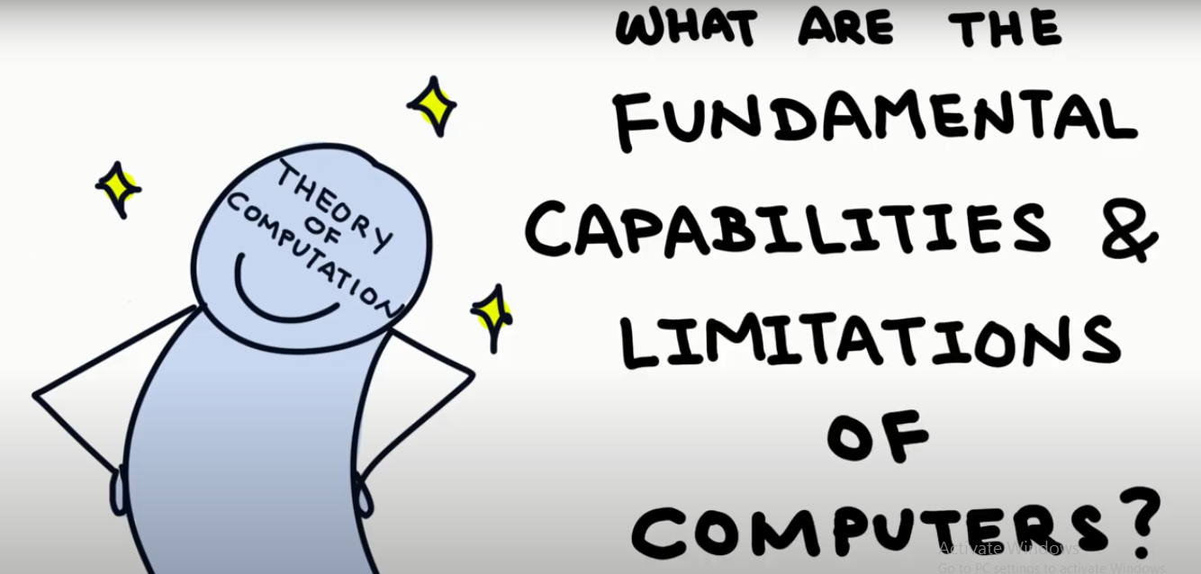

Slide 7
Domains of TOC
Computability
Complexity
Automata Theory
It deals with definitions and properties of different “mathematical model of computation”.
Types of automata:
1. Finite automata
2. Pushdown automata
3. Turing machine
Which problems can be solved by computer and which one cannot?
Classify problems as being solvable or unsolvable.
It Classifies problems according to their degree of the “computational difficulty”.
How hard the problem is?

Slide 8
Units
Sr. No | Unit
1 | Review of Mathematical Terms and Theory
2 | Finite automata
3 | Context free grammar
4 | Pushdown Automata and CFL
5 | Turing Machine

Slide 9
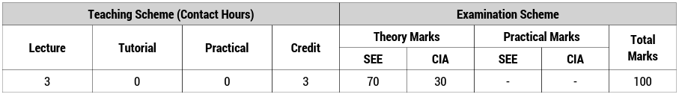
Teaching and Examination scheme

Slide 10
Unit – 1 Review of Mathematical Theory
Theory of Computation (TOC)
DU # 2101CS603
Prof. Dixita B. Kagathara
Computer Engineering Department
dixita.kagathara@darshan.ac.in
+91 - 97277 47317 (CE Department)

Slide 11
Topics to be covered
Basic mathematical notation
Set theory
Logic
Functions
Relations
Proof
Mathematical induction
Strong principle of mathematical induction
Languages

Looping

Slide 12
Set

Slide 13

Set
A set is a collection of objects.
The objects in a set are called elements of the set.
Examples:
A = {11, 12, 21, 22}
B = {11, 12, 21, 11, 12, 22}
C = {x | x is odd integer greater than 1}
D = {x | x Є B and x ≤ 11}
Roster Notation
Set-builder Notation

Slide 14

Operations on Sets
Operations on the sets are:
Complement
Union
Intersection
Set Difference
Symmetric Difference
Cartesian product
The complement of a set A is the set A’ of everything that is not an element of A from Universal Set U.
Example:
U = {1,2,3,4,5}
A = {1,2}
A’ = {3,4,5}
$$A’ = \{x ∈ U | x ∉ A\}$$
U
A

Slide 15

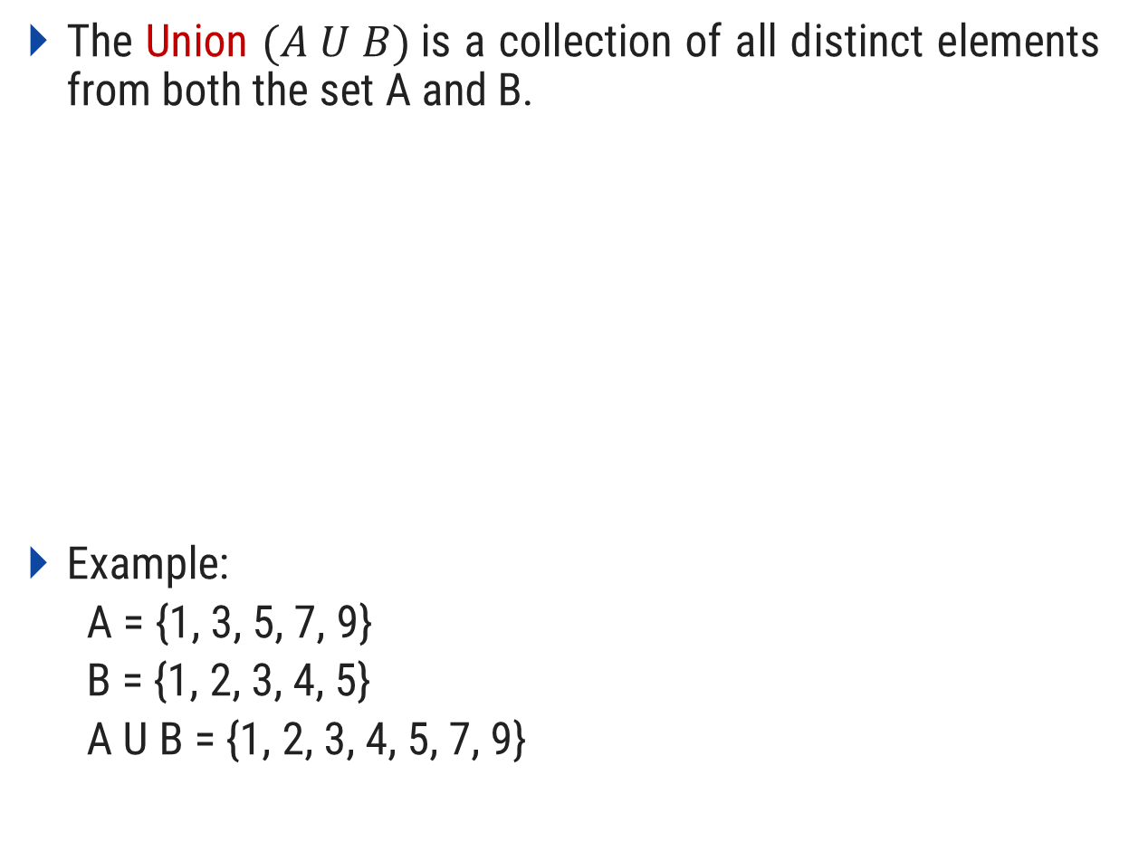


Operations on Sets
Operations on the sets are:
Complement
Union
Intersection
Set Difference
Symmetric Difference
Cartesian product
The Union $(A U B)$is a collection of all distinct elements from both the set A and B.
Example:
A = {1, 3, 5, 7, 9}
B = {1, 2, 3, 4, 5}
A U B = {1, 2, 3, 4, 5, 7, 9}
$$A U B = \{x | x ∈ A or x ∈ B\}$$
U
$$A$$
$$B$$

Slide 16
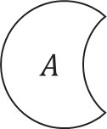

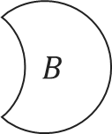
Operations on Sets
Operations on the sets are:
Complement
Union
Intersection
Set Difference
Symmetric Difference
Cartesian product
The intersection A ∩ B of two sets A and B is the set that contains all elements of A that also belong to B, but no other elements.
Example:
A = {1, 3, 5, 7, 9}
B = {1, 2, 3, 4, 5}
A ∩ B = {1, 3, 5}
$$A∩B = \{x | x ∈ A and x ∈ B\}$$
U
$$A$$
$$B$$

Slide 17
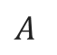
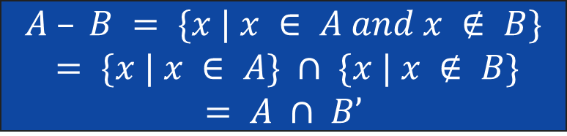
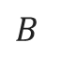
Operations on Sets
Operations on the sets are:
Complement
Union
Intersection
Set Difference
Symmetric Difference
Cartesian product
The set difference A - B of two sets A and B is the set of everything in A but not in B.
Example:
A = {1, 3, 5, 7, 9}
B = {1, 2, 3, 4, 5}
A - B = {7, 9}
$$A – B = \{x | x ∈ A and x ∉ B\}$$
$$= \{x | x ∈ A\} ∩ \{x | x ∉ B\}$$
$$= A ∩ B’$$
U
$$A$$
$$B$$

Slide 18

Operations on Sets
Operations on the sets are:
Complement
Union
Intersection
Set Difference
Symmetric Difference
Cartesian product
The symmetric difference A ⊖ B of two sets A and B is the set of everything in A but not in B or the set of everything in B but not in A.
Example:
A = {1, 3, 5, 7, 9}
B = {1, 2, 3, 4, 5}
A ⊖ B = {7, 9, 2, 4}
$$A ⊖ B = (A – B) U (B – A)$$
U

Slide 19
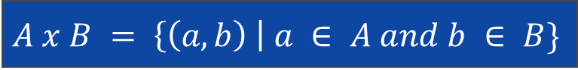
Operations on Sets
Operations on the sets are:
Complement
Union
Intersection
Set Difference
Symmetric Difference
Cartesian product
The Cartesian product A x B of two sets A and B is the set of all ordered pairs (a, b) where a ∈ A and b ∈ B.
Example:
A = {1, 3, 5}
B = {2, 4}
A x B = {(1,2), (1,4), (3,2), (3,4), (5,2), (5,4)}
$$A x B = \left\{\left(a,b\right) \right| a ∈ A and b ∈ B\}$$

Slide 20
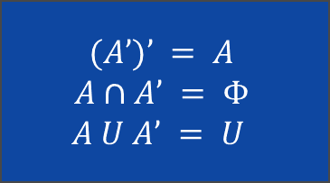






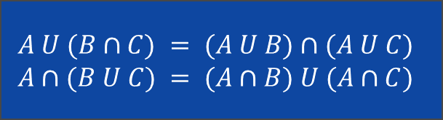
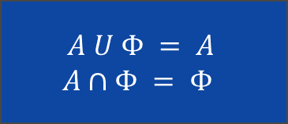
Set of identities
Commutative laws
Associative laws
Distributive laws
Idempotent laws
Absorptive laws
De Morgan laws
Other complements laws
Other empty set laws
Other universal set laws
$$A∩B = B∩A$$
$$A U B = B U A$$
$$A U A = A$$
$$A∩A = A$$
$$(A’)’ = A$$
$$A∩A’ = Φ$$
$$A U A’ = U$$
$$A∩(B∩C) =(A∩B)∩C$$
$$A U (B U C) =(A U B) U C$$
$$A U (A∩B) = A$$
$$A∩(A U B) = A$$
$$A U Φ = A$$
$$A∩Φ = Φ$$
$$A U (B∩C) = (A U B)∩(A U C)$$
$$A∩(B U C) = (A∩B) U (A∩C)$$
$$(A U B)’ = A’∩B’$$
$$(A∩B)’ = A’ U B’$$
$$A U U = U$$
$$A∩U = A$$

Slide 21
Logic

Slide 22
Propositions
Declarative statement that is sufficiently objective, meaningful and precise to have a truth value (true or false) is known as proposition.
Examples:
p : Fourteen is an even integer.
r : 0 = 0
q : Mumbai is the capital city of India.
s : a²+b²=4

Slide 23
Logical Connectives
Logical Connectives
Conjunction
Disjunction
Negation
Conditional Connective
The logical connective Conjunction (And) is true only when both of the propositions are true.
Example: Truth table
p : It is raining
q : It is warm
r : It is raining AND it is warm
p | q | r = p ^ q
True | True | True
True | False | False
False | True | False
False | False | False

Slide 24
Logical Connectives
Logical Connectives
Conjunction
Disjunction
Negation
Conditional Connective
The logical disjunction, or logical OR, is true if one or both of the propositions are true.
Example: Truth table
p : 2 + 2 = 5
q : 1 < 2
r : 2 + 2 = 5 OR 1 < 2
p | q | r = p v q
True | True | True
True | False | True
False | True | True
False | False | False

Slide 25
Logical Connectives
Logical Connectives
Conjunction
Disjunction
Negation
Conditional Connective
¬p, the negation of a proposition p, is also a proposition.
Example: Truth table
p : John studies.
¬p : John does NOT study.
P | ¬P
True | False
False | True

Slide 26
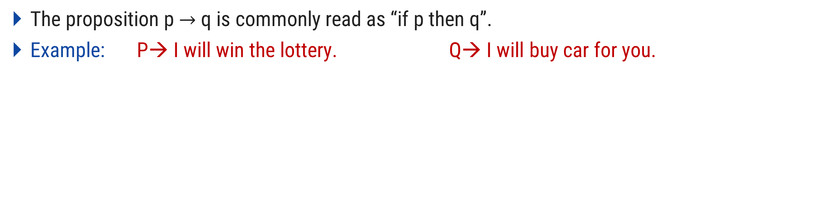
Logical Connectives
Logical Connectives
Conjunction
Disjunction
Negation
Conditional Connective
The proposition p $→$ q is commonly read as “if p then q”.
Example: P→ I will win the lottery. Q→ I will buy car for you.
I win the lottery | I will buy car for you | Promise kept/ broken/ not broken
Yes | Yes | Kept
Yes | No | Broken
No | Yes | Not broken
No | No | Not broken
p | q | p→q
True | True | True
True | False | False
False | True | True
False | False | True

Slide 27
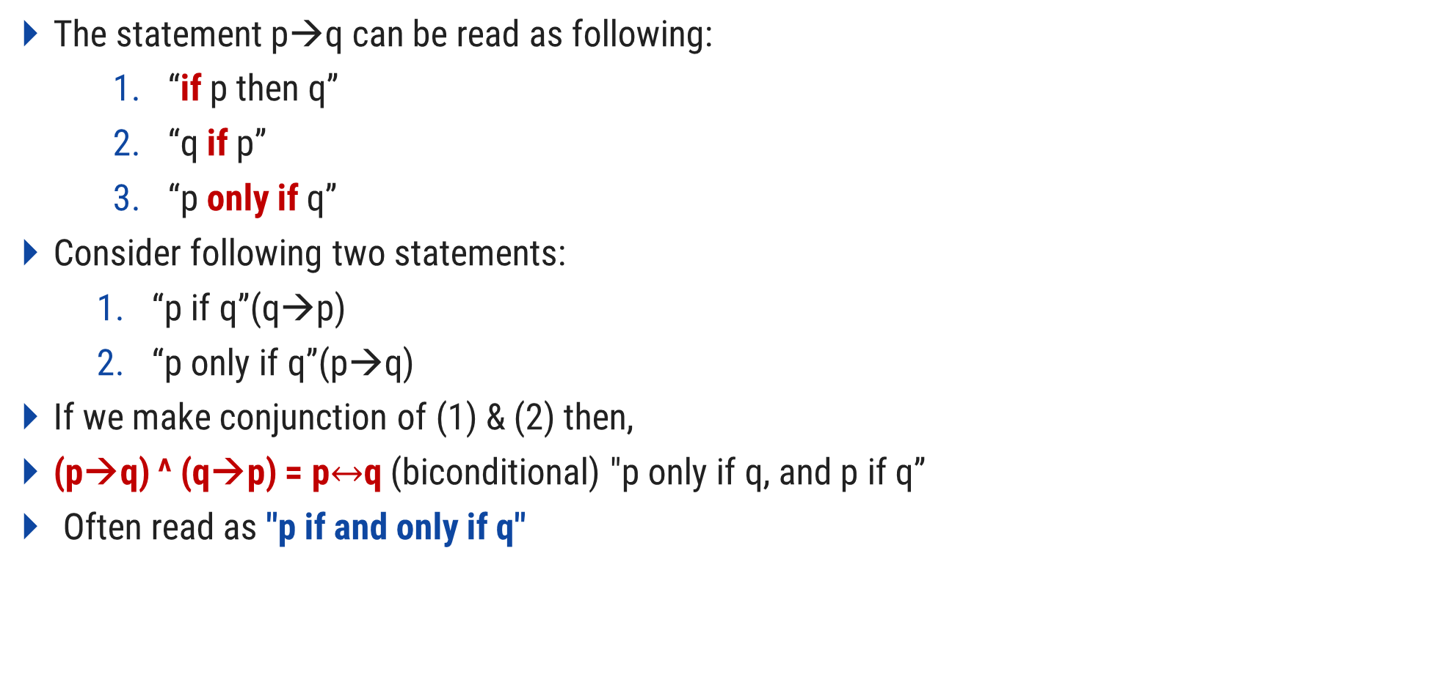
Logical Connectives
The statement p→q can be read as following:
“if p then q”
“q if p”
“p only if q”
Consider following two statements:
“p if q”(q→p)
“p only if q”(p→q)
If we make conjunction of (1) & (2) then,
(p→q) ^ (q→p) = p$↔$q (biconditional) "p only if q, and p if q”
Often read as "p if and only if q"

Slide 28
Tautology and Contradiction
A Compound proposition is called tautology if it is true in every case.
Example:
A contradiction is opposite.
If p is tautology, ¬P is contradiction.
P | ¬P | P v ¬P
T | F | T
T | F | T
F | T | T
F | T | T
Tautology

Slide 29
Example
Check whether (p v q) ^ ¬(p→q) is tautology?
P → (¬P V ¬Q). Is it a tautology? A contradiction? Or neither? Justify your answer.
p | q | p v q
T | T | T
T | F | T
F | T | T
F | F | F
p→q
T
F
T
T
¬(p→q)
F
T
F
F
(p v q) ^ ¬(p→q)
F
T
F
F
Not Tautology

Slide 30
Logical Quantifiers
Logical Quantifier
Universal Quantifier
Existential Quantifier
Represented by an upside-down A: ∀ (“for all”).
Example:
Let P(x) = x+1 > x, ∀x P(x)
English translation: “for all values of x, P(x) is true”
English translation: “for all values of x, x+1>x is true”

Slide 31
Logical Quantifiers
Logical Quantifier
Universal Quantifier
Existential Quantifier
Represented by ∃ : ∃ (“for exists”).
Example:
Let P(x) = x+1 > x
There is a numerical value for which x+1>x
Thus, ∃x P(x) is true

Slide 32
Functions

Slide 33
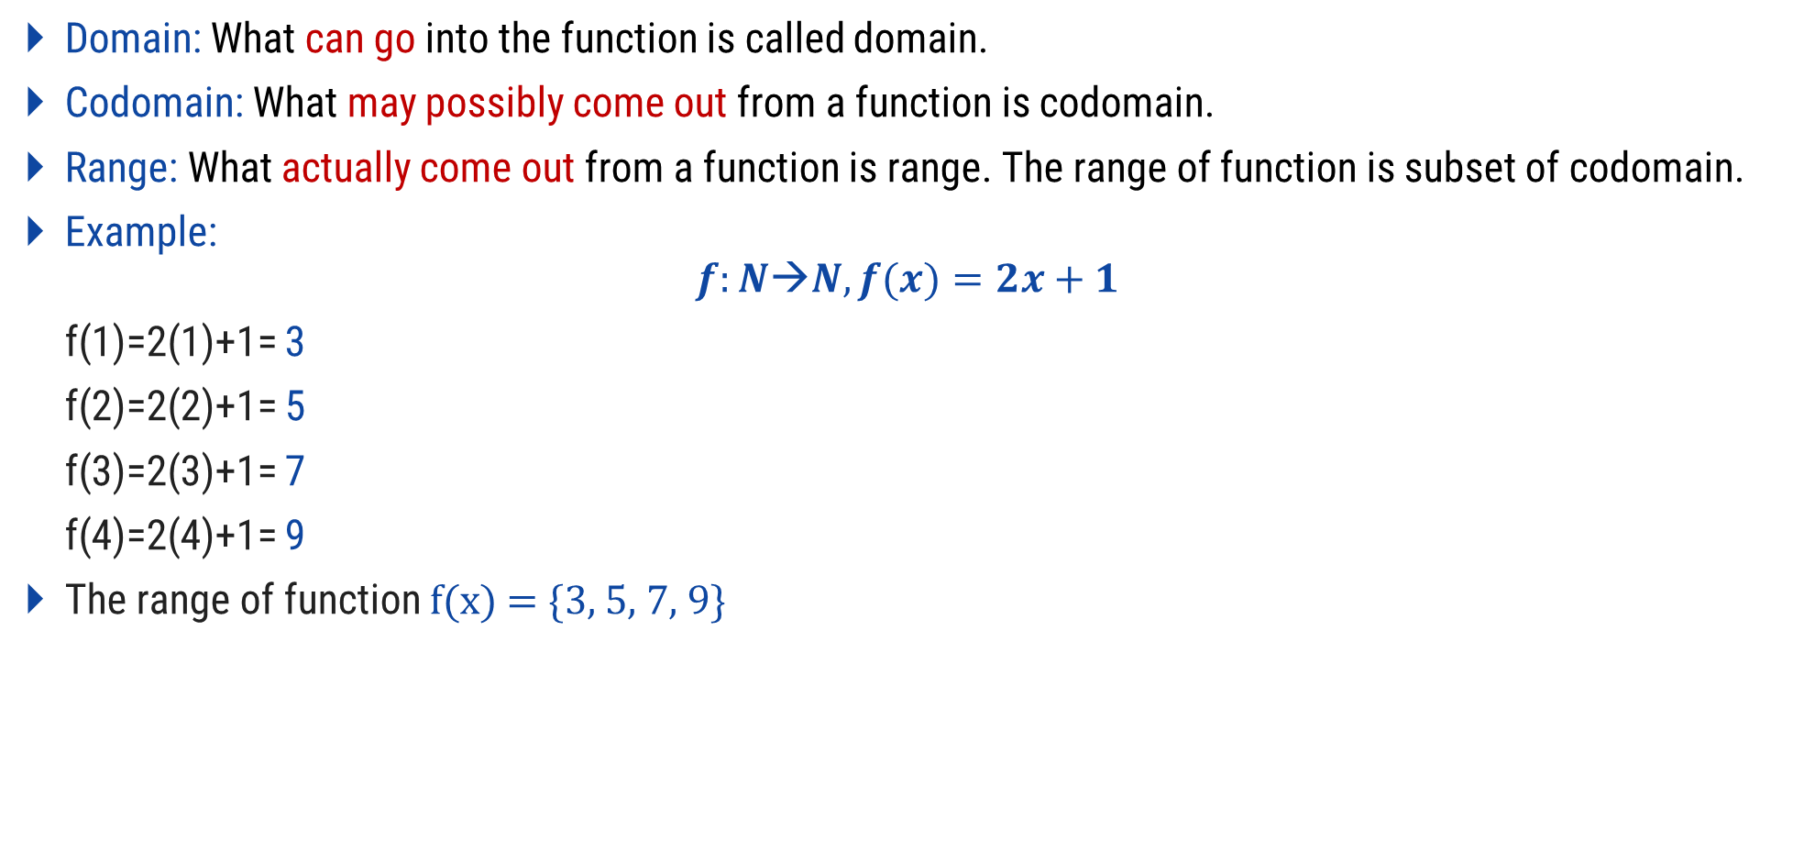
Functions
Domain: What can go into the function is called domain.
Codomain: What may possibly come out from a function is codomain.
Range: What actually come out from a function is range. The range of function is subset of codomain.
Example:
$$f:N→N, f(x)=2x+1$$
f(1)=2(1)+1= 3
f(2)=2(2)+1= 5
f(3)=2(3)+1= 7
f(4)=2(4)+1= 9
The range of function f(x) = {3, 5, 7, 9}
A
B
1
1
2
3
Range
2
4
5
3
6
7
4
8
9
10
Domain
Codomain

Slide 34
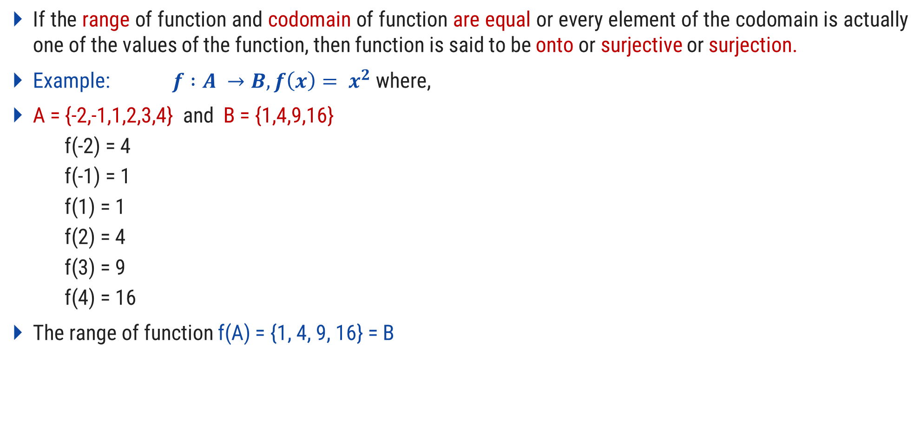
Onto Function
If the range of function and codomain of function are equal or every element of the codomain is actually one of the values of the function, then function is said to be onto or surjective or surjection.
Example: $f :A →B, f\left(x\right)= x^{2}$ where,
A = {-2,-1,1,2,3,4} and B = {1,4,9,16}
f(-2) = 4
f(-1) = 1
f(1) = 1
f(2) = 4
f(3) = 9
f(4) = 16
The range of function f(A) = {1, 4, 9, 16} = B
A
B
-2
-1
1
1
4
2
9
3
4
16

Slide 35
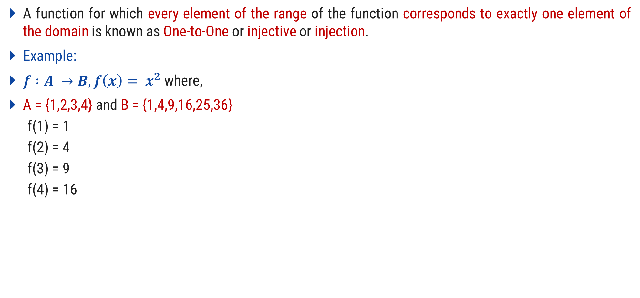
One-to-One Function
A function for which every element of the range of the function corresponds to exactly one element of the domain is known as One-to-One or injective or injection.
Example:
$f :A →B, f\left(x\right)= x^{2}$ where,
A = {1,2,3,4} and B = {1,4,9,16,25,36}
f(1) = 1
f(2) = 4
f(3) = 9
f(4) = 16
A
B
1
1
2
4
3
9
16
4
25
36

Slide 36
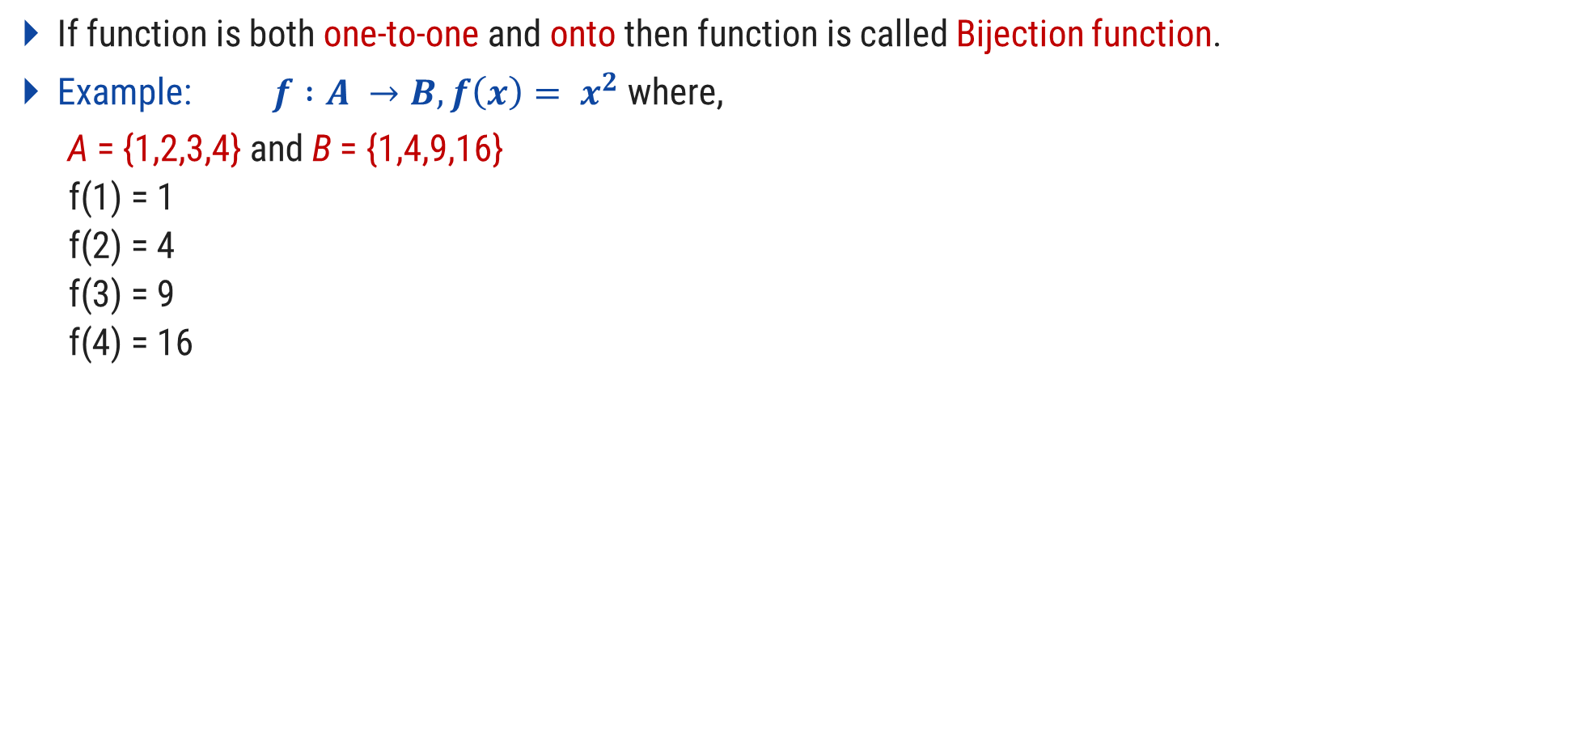
Bijection Function
If function is both one-to-one and onto then function is called Bijection function.
Example: $f :A →B, f\left(x\right)= x^{2}$ where,
A = {1,2,3,4} and B = {1,4,9,16}
f(1) = 1
f(2) = 4
f(3) = 9
f(4) = 16
A
B
1
1
2
4
3
9
16
4

Slide 37
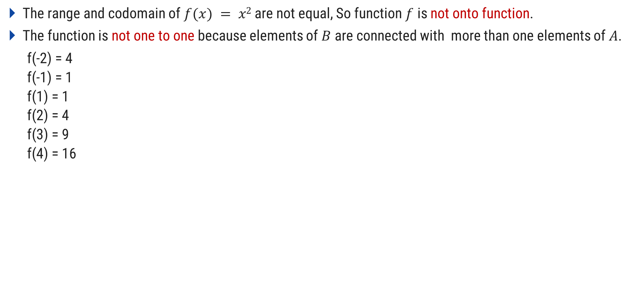
Prove that f: R → R, f(x) = x² is not one-to-one and not onto function
The range and codomain of $f(x) = x2$are not equal, So function $f$ is not onto function.
The function is not one to one because elements of $B$ are connected with more than one elements of $A$.
f(-2) = 4
f(-1) = 1
f(1) = 1
f(2) = 4
f(3) = 9
f(4) = 16
A
B
-2.0
-2.0
-1.0
-1.0
1.0
1.0
2.0
4.0
3.0
9.0
4.0
16.0

Slide 38
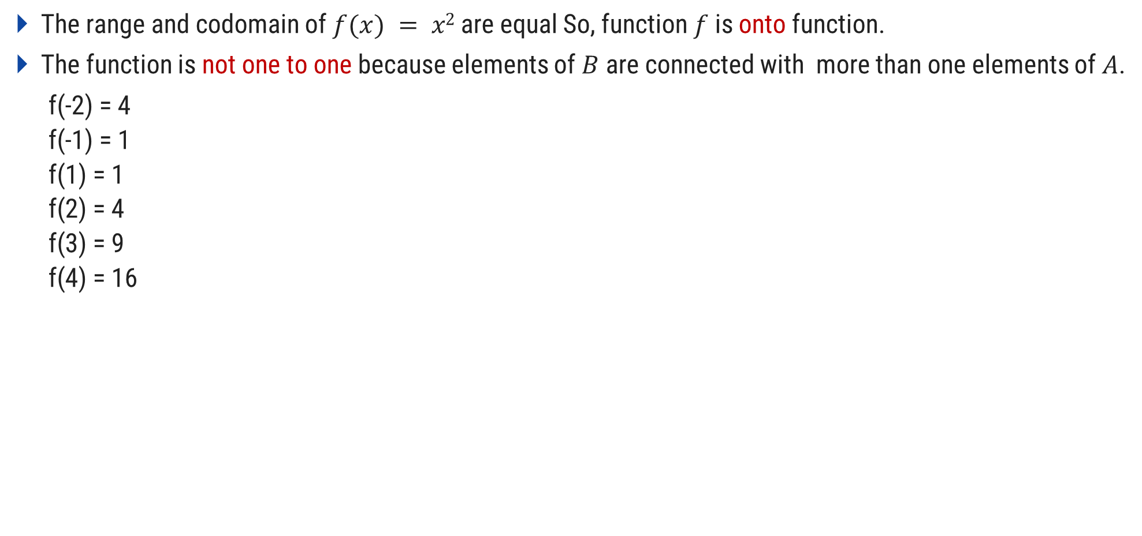
Prove that f: R → R⁺, f(x) = x² is not one-to-one and onto function
The range and codomain of $f(x) = x2$are equal So, function $f$is onto function.
The function is not one to one because elements of $B$ are connected with more than one elements of $A$.
f(-2) = 4
f(-1) = 1
f(1) = 1
f(2) = 4
f(3) = 9
f(4) = 16
A
B
-2.0
-1.0
1.0
1.0
2.0
4.0
3.0
9.0
4.0
16.0

Slide 39
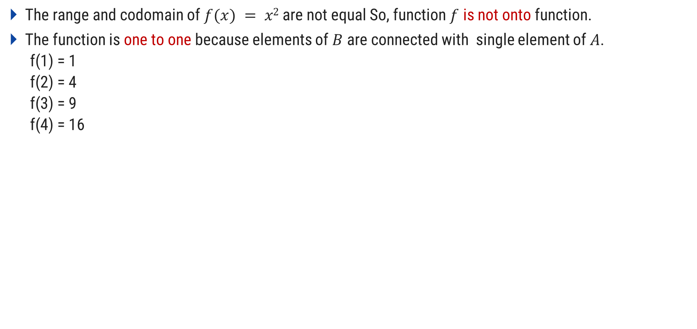
Prove that f: R⁺ → R, f(x) = x² is one-to-one and not onto function
The range and codomain of $f(x) = x2$are not equal So, function $f$ is not onto function.
The function is one to one because elements of $B$ are connected with single element of $A$.
f(1) = 1
f(2) = 4
f(3) = 9
f(4) = 16
A
B
-2.0
-1.0
1.0
1.0
2.0
4.0
3.0
9.0
4.0
16.0

Slide 40
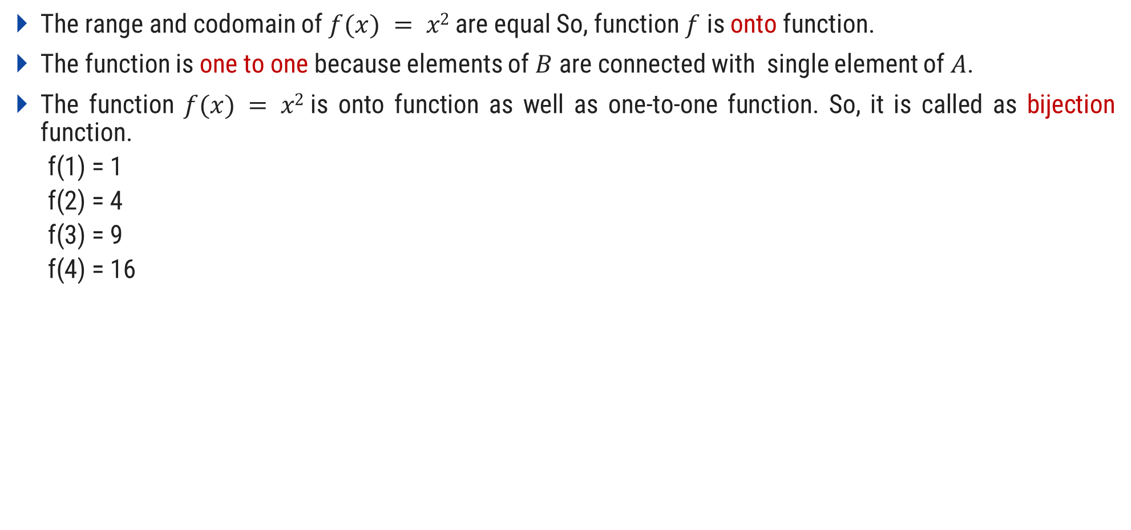
Prove that f: R⁺ → R⁺, f(x) = x² is one-to-one and onto function (bijection)
The range and codomain of $f(x) = x2$are equal So, function $f$ is onto function.
The function is one to one because elements of $B$ are connected with single element of $A$.
The function $f(x) = x2$is onto function as well as one-to-one function. So, it is called as bijection function.
f(1) = 1
f(2) = 4
f(3) = 9
f(4) = 16
A
B
1.0
1.0
2.0
4.0
3.0
9.0
4.0
16.0

Slide 41
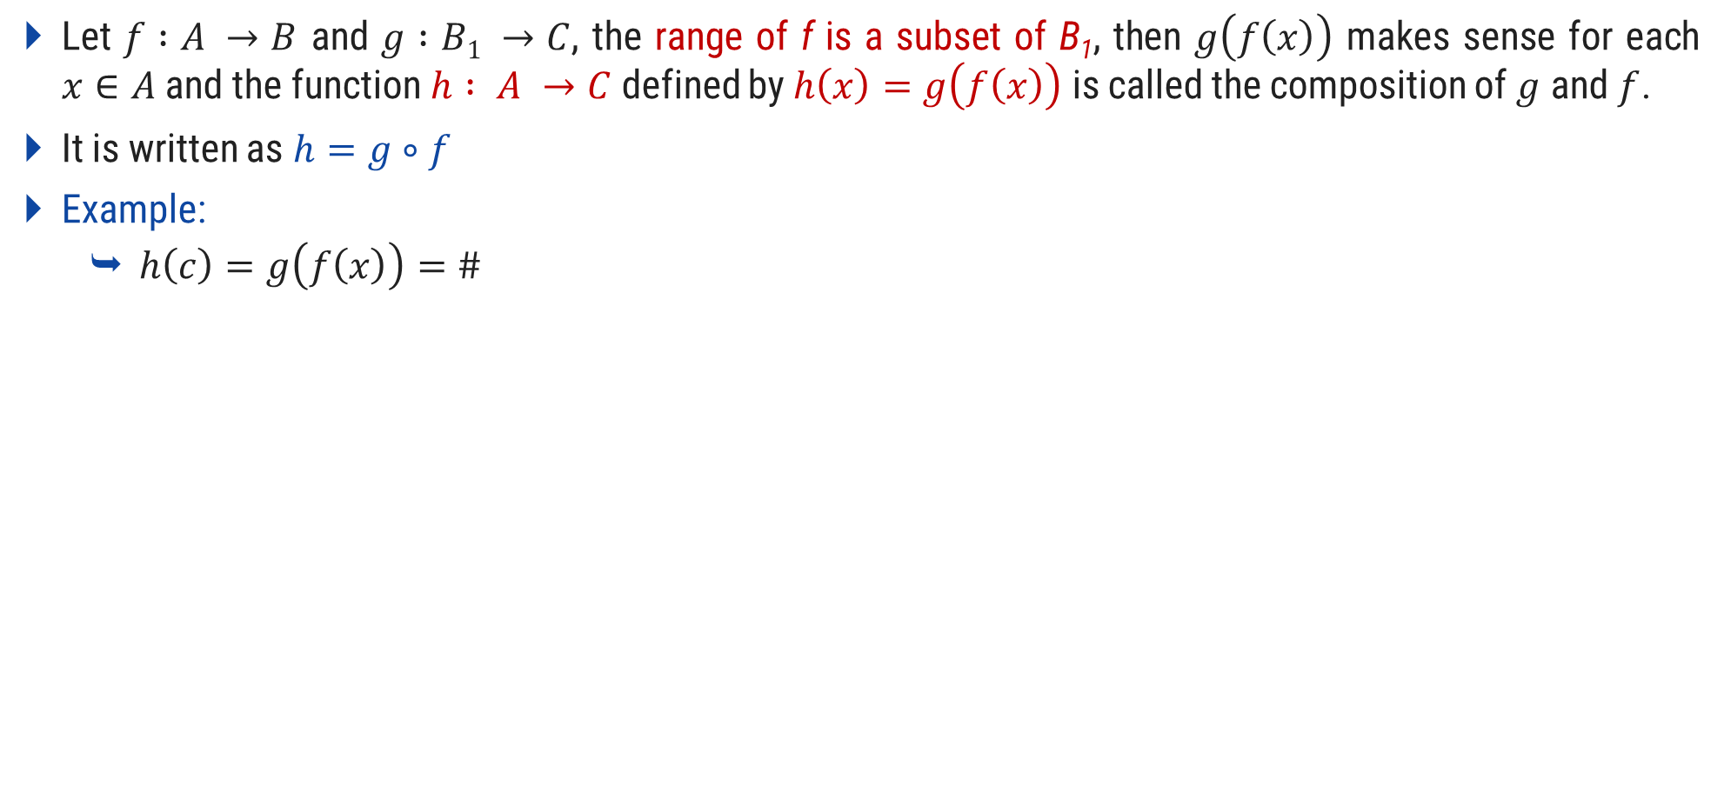
Compositions of Function
Let $f :A →B$ and $g :B1 →C$, the range of f is a subset of B₁, then $g\left(f\left(x\right)\right)$ makes sense for each $x∈A$ and the function $h : A →C$ defined by $h\left(x\right)=g\left(f\left(x\right)\right)$ is called the composition of $g$ and $f$.
It is written as $h=g∘f$
Example:
$h\left(c\right)=g\left(f\left(x\right)\right)=\#$
f
g
A
B
B₁
C
a
1
@
b
2
#
c
3
!
d
4

Slide 42
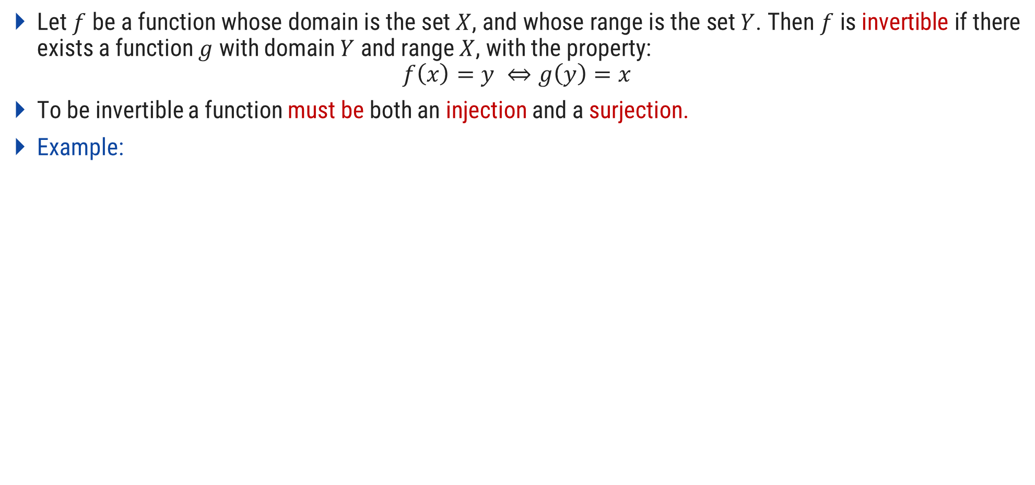
Inverse of Function
Let $f$ be a function whose domain is the set $X$, and whose range is the set $Y$. Then $f$ is invertible if there exists a function $g$ with domain $Y$ and range $X$, with the property:
$$f\left(x\right)=y ⇔g\left(y\right)=x$$
To be invertible a function must be both an injection and a surjection.
Example:
A
B
A
B
a
1
1
a
b
2
f
2
b
f⁻¹
c
3
3
c
d
4
4
d

Slide 43
Relations

Slide 44
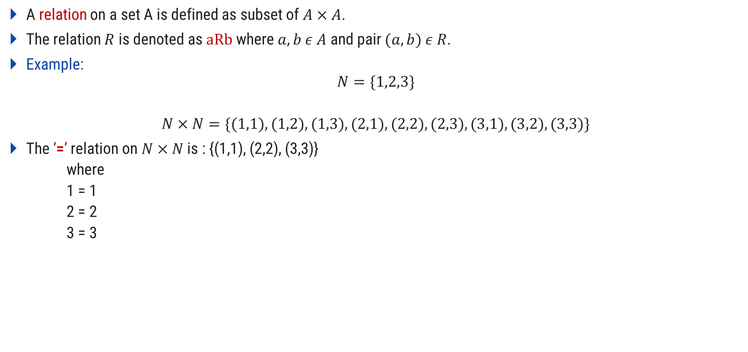
Relations
A relation on a set A is defined as subset of $A×A$.
The relation $R$ is denoted as $aRb$ where $a,b ε A$ and pair $(a,b) ε R$.
Example:
$$N=\{1,2,3\}$$
$$N×N=\{(1,1),(1,2),(1,3),(2,1),(2,2),(2,3),(3,1),(3,2),(3,3)\}$$
The ‘=‘ relation on $N×N$ is : {(1,1), (2,2), (3,3)}
where
1 = 1
2 = 2
3 = 3

Slide 45
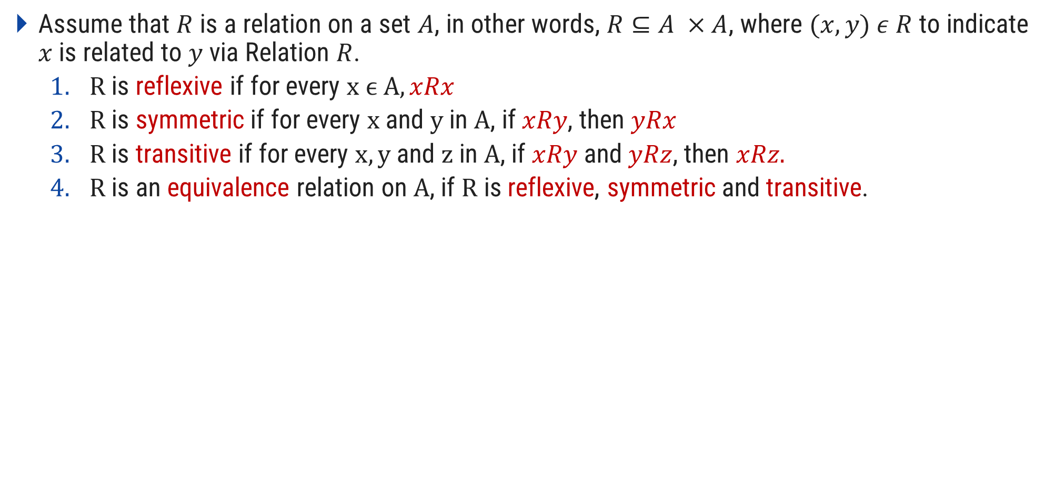
Properties of Equivalence Relations
Assume that $R$ is a relation on a set $A$, in other words, $R⊆A ×A$, where $(x,y) ε R$ to indicate $x$ is related to $y$ via Relation $R$.
$R$ is reflexive if for every $x ϵ A, xRx$
$R$ is symmetric if for every $x$ and $y$ in $A$, if $xRy$, then $yRx$
$R$ is transitive if for every $x,y$ and $z$ in $A$, if $xRy$ and $yRz$, then $xRz.$
$R$ is an equivalence relation on $A$, if $R$ is reflexive, symmetric and transitive.

Slide 46

Example: Equivalence Relation
A={a, b}, R={(a, a), (b, b), (a, b), (b, a)}
Reflexive: {(a, a),(b, b)}
Symmetric: {(a, b), (b, a)}
Transitive: {(a, a), (a, b), (a, b)
(b, b), (b, a), (b, a)
(a, b), (b, b), (a, b)
(a, b), (b, a), (a, a)
(b, a), (a, b), (b, b)
(b, a), (a, a), (b, a)}
Above relation is Equivalence relation because it is Reflexive, symmetric and transitive.

Slide 47
Exercise
A={1, 2, 3}, R={(1, 2), (1, 1), (2, 1), (2, 2), (3, 2), (3, 3)} is equivalent relation?
A={1, 2, 3, 4}, R={(1, 1), (2, 2), (2, 3), (3, 2), (4, 2), (4, 4)} is equivalent relation?
A={0, 1, 2}, R={(0, 0), (1, 1), (2, 2), (1, 0), (2, 1)} is equivalent relation?

Slide 48
Proof

Slide 49
Proof
A proof of a statement is essentially just a convincing argument that the statement is true.
A typical step in proof is to derive some statement from:
Assumptions or hypotheses
Statements that have already been derived
Other generally accepted facts
There are several methods for establishing a proof, some of them are:
Direct proof
By contradiction
By mathematical induction

Slide 50
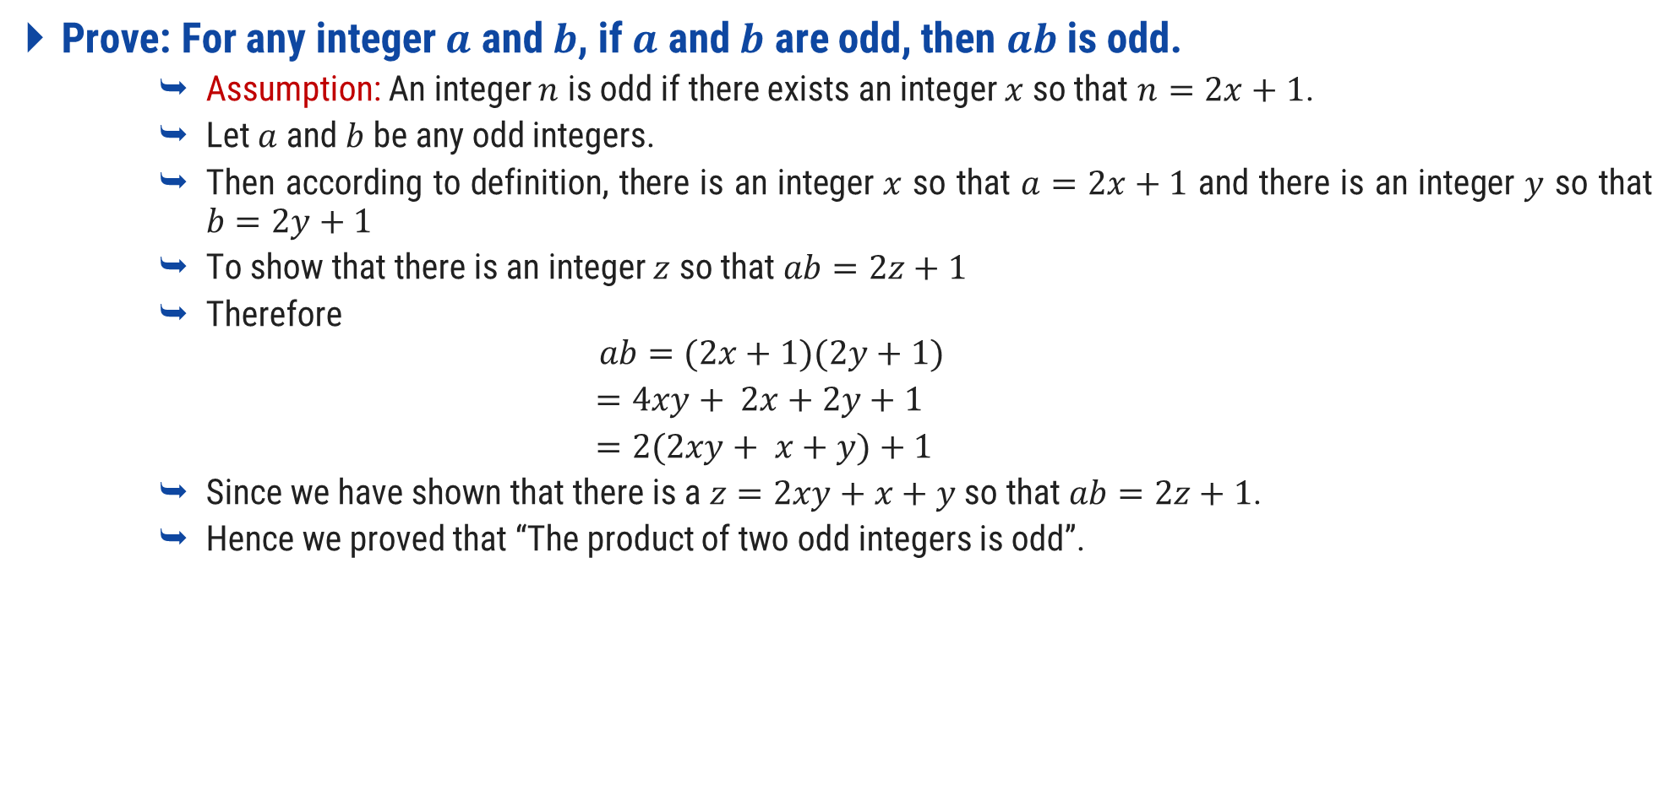
Prove: Product of Two Odd Integers is Odd
Prove: For any integer $a$ and $b$, if $a$ and $b$ are odd, then $ab$ is odd.
Assumption: An integer $n$ is odd if there exists an integer $x$ so that $n=2x+1$.
Let $a$ and $b$ be any odd integers.
Then according to definition, there is an integer $x$ so that $a=2x+1$ and there is an integer $y$ so that $b=2y+1$
To show that there is an integer $z$ so that $ab=2z+1$
Therefore
$$ab=(2x+1)(2y+1)$$
$=4xy+ 2x+2y+1$
$=2(2xy+ x+y)+1$
Since we have shown that there is a $z=2xy+x+y$ so that $ab=2z+1$.
Hence we proved that “The product of two odd integers is odd”.

Slide 51
Rational & Irrational numbers
A rational number is a number that can be in the form m/n where m and n are integers and n is not equal to zero.
Examples:
1.5 = 3/2
6 = 12/2
5 = 15/3
π=22/7= 3.14159265 3589793238462643383279502884197..…
Rational Numbers
Irrational Numbers

Slide 52
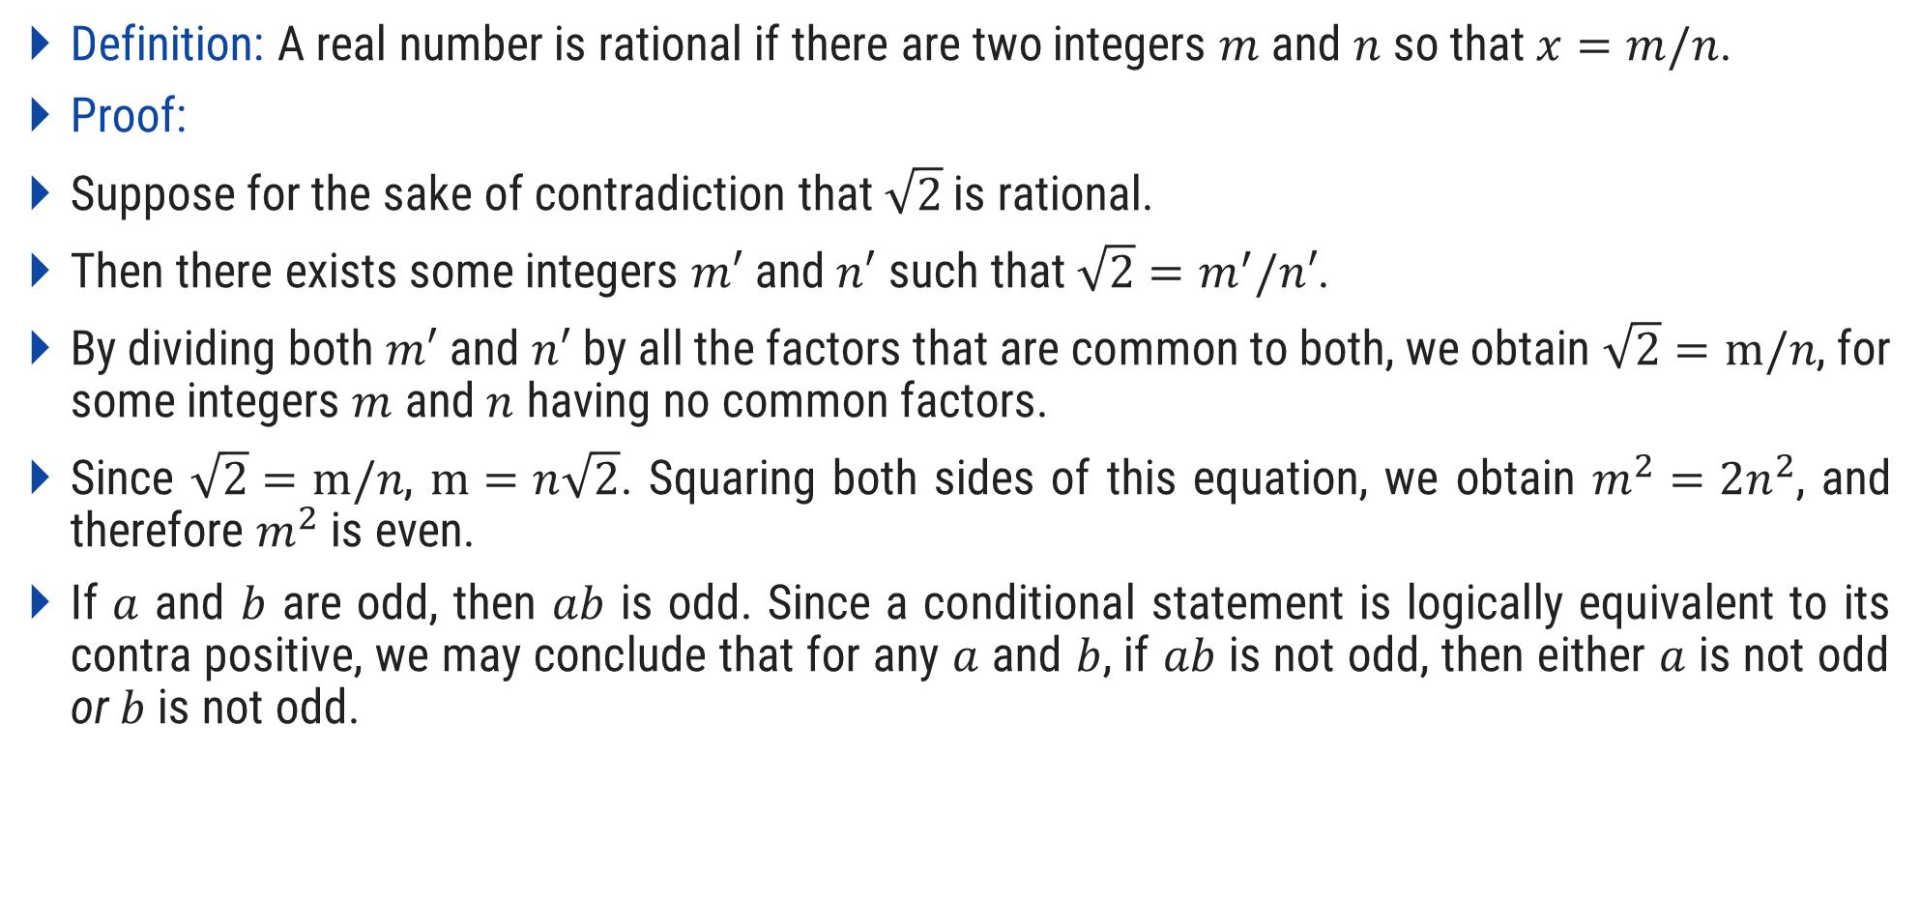
Prove: $\sqrt{2}$ is Irrational
Definition: A real number is rational if there are two integers $m$ and $n$ so that $x=m/n$.
Proof:
Suppose for the sake of contradiction that $\sqrt{2}$ is rational.
Then there exists some integers $m′$ and $n′$ such that ${\sqrt{2}=m}^{′}/n′$.
By dividing both $m′$ and $n′$ by all the factors that are common to both, we obtain $\sqrt{2}=m/n$, for some integers $m$ and $n$ having no common factors.
Since $\sqrt{2}=m/n$, $m=n\sqrt{2}$. Squaring both sides of this equation, we obtain $m^{2}=2n^{2}$, and therefore $m^{2}$ is even.
If $a$ and $b$ are odd, then $ab$ is odd. Since a conditional statement is logically equivalent to its contra positive, we may conclude that for any $a$ and $b$, if $ab$ is not odd, then either $a$ is not odd or $b$ is not odd.

Slide 53
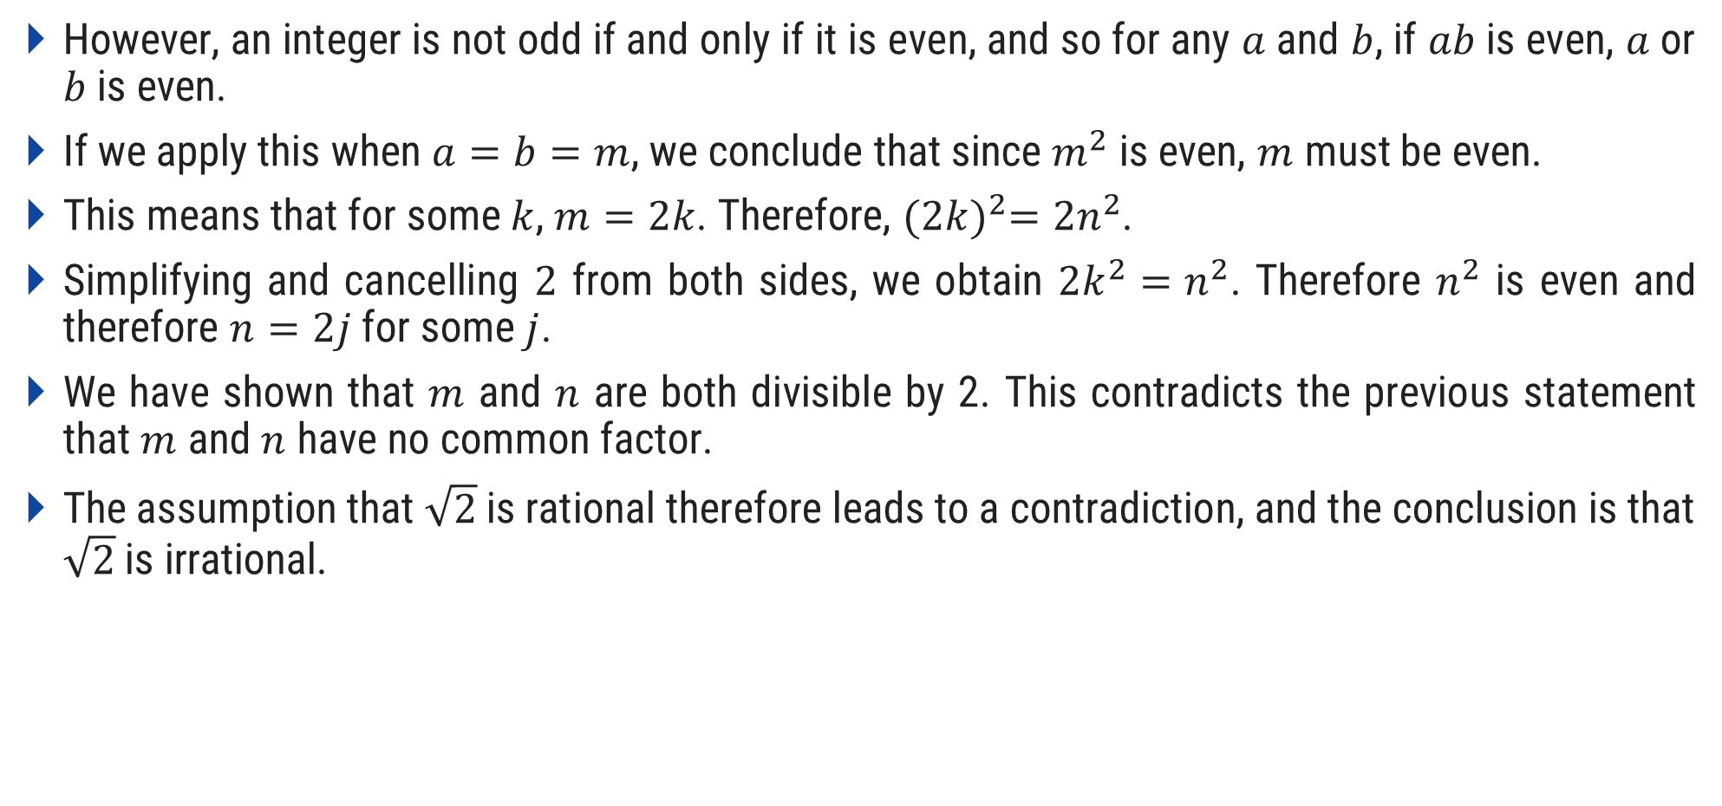
Prove: $\sqrt{2}$ is Irrational
However, an integer is not odd if and only if it is even, and so for any $a$ and $b$, if $ab$ is even, $a$ or $b$ is even.
If we apply this when $a=b=m$, we conclude that since $m^{2}$ is even, $m$ must be even.
This means that for some $k$, $m=2k$. Therefore, ${(2k)}^{2}=2n^{2}$.
Simplifying and cancelling $2$ from both sides, we obtain $2k^{2}=n^{2}$. Therefore $n^{2}$ is even and therefore $n=2j$ for some $j$.
We have shown that $m$ and $n$ are both divisible by 2. This contradicts the previous statement that $m$ and $n$ have no common factor.
The assumption that $\sqrt{2}$ is rational therefore leads to a contradiction, and the conclusion is that $\sqrt{2}$ is irrational.

Slide 54
Principle of Mathematical Induction

Slide 55


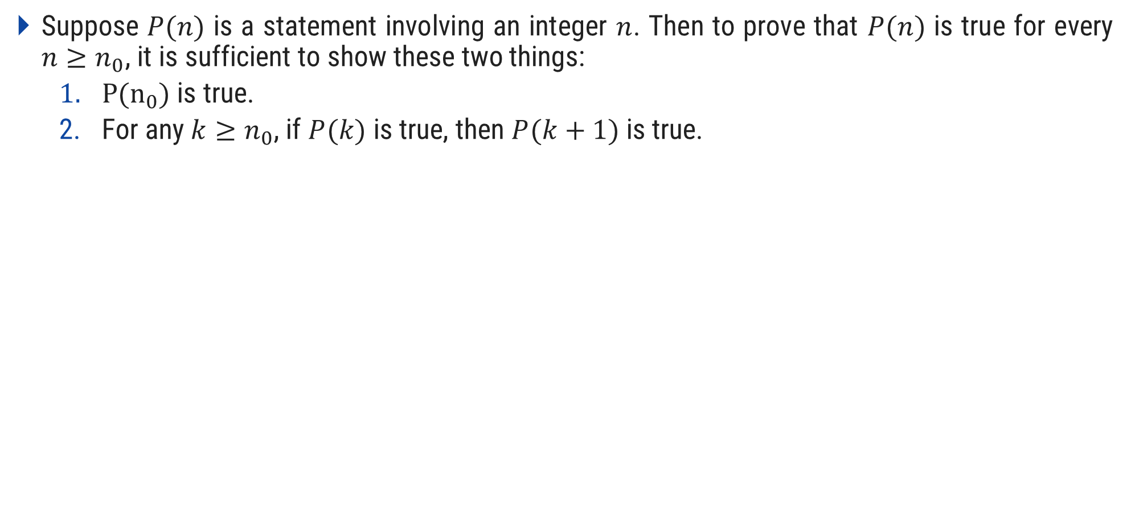
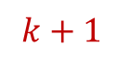

Principle of Mathematical Induction
Suppose $P(n)$ is a statement involving an integer $n$. Then to prove that $P(n)$ is true for every $n≥n_{0}$, it is sufficient to show these two things:
$P(n_{0})$ is true.
For any $k≥n_{0}$, if $P(k)$ is true, then $P(k+1)$ is true.
$$k+1$$
$$k$$
Basic

Slide 56
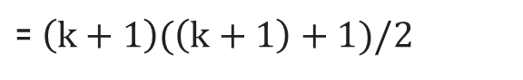
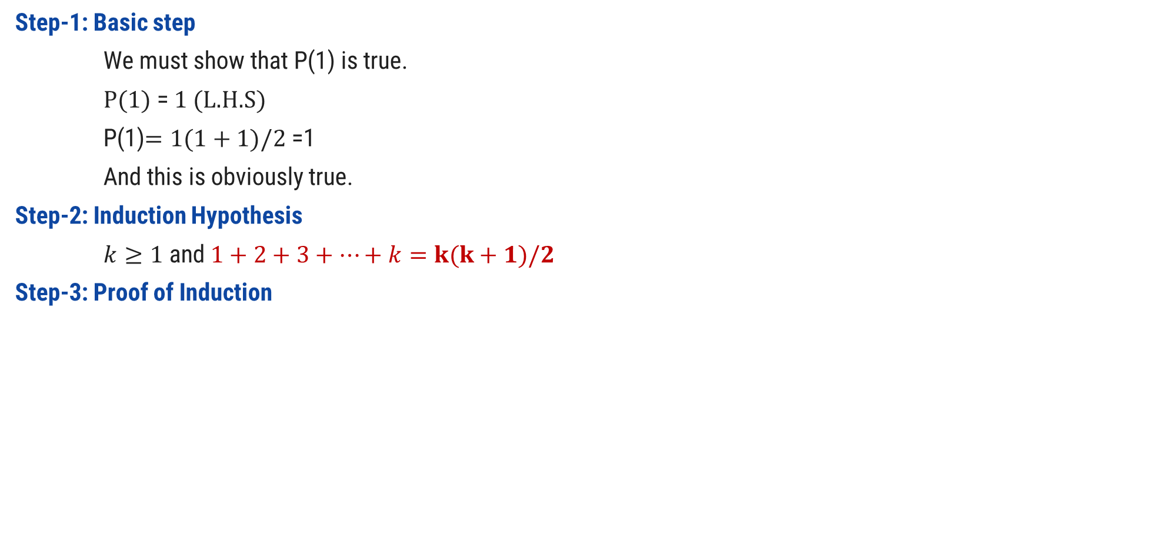
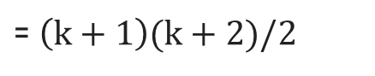
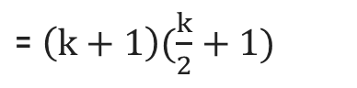
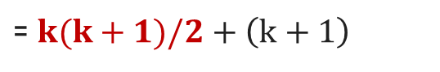
Prove $\sum_{i=1}^{n}{i}=n(n+1)/2$ using PMI
Step-1: Basic step
We must show that P(1) is true.
$P(1)$ = $1$ (L.H.S)
P(1)$=1(1+1)/2$ =1
And this is obviously true.
Step-2: Induction Hypothesis
$k≥1$ and $1+2+3+…+k=k(k+1)/2$
Step-3: Proof of Induction
$$P(k+1)$$ | = $1+2+3+…k+\left(k+1\right)$
= $k(k+1)/2+\left(k+1\right)$
(by induction hypothesis)
= $\left(k+1\right)(\frac{k}{2}+1)$
= $\left(k+1\right)(k+2)/2$
= $\left(k+1\right)(\left(k+1\right)+1)/2$
(Hence Proved)

Slide 57
Prove 1 +3 +5 + … +2n-1 = n² using PMI, n>=1
Step-1: Basic step
We must show that P(1) is true.
P(1) = 2(1)-1= 1 (L.H.S)
P(1) = (1)² = 1 (R.H.S)
And, this is obviously true.
Step-2: Induction Hypothesis
k >= 1 and
p(k) = 1+3+5+…..+(2k-1)=k²
Step-3: Proof of Induction
P(k+1) = 1+3+5+….+(2k-1)+(2(k+1)-1)
= k² + (2(k+1)-1)
= k² + (2k+2-1)
= k² + 2k+1
=(k+1)² (Hence Proved)

Slide 58
Prove 7+ 13+19+…..+(6n+1)= n(3n+4) using PMI, n>=1
Step-1: Basic step
We must show that p(1) is true.
P(1)= 6n+1=(6(1)+1)=7
P(1)= n(3n+4) =1(3(1)+4)=7
And, this is obviously true.
Step-2: Induction Hypothesis
k >= 1 and
p(k) = 7+13+19+…..+(6k+1)=k(3k+4)
Step-3: Proof of Induction
P(k+1)= 7+13+…..+(6k+1)+(6(k+1)+1)
= k(3k+4)+(6(k+1)+1)
= k(3k+4)+(6k+6+1)
= 3k²+4k+6k+7
= 3k²+10k+7
= 3k²+3k+7k+7
= 3k(k+1)+7(k+1)
= (k+1)(3k+7)
= (k+1)(3k+3+4)
= (k+1)(3(k+1)+4) (Hence Proved)

Slide 59
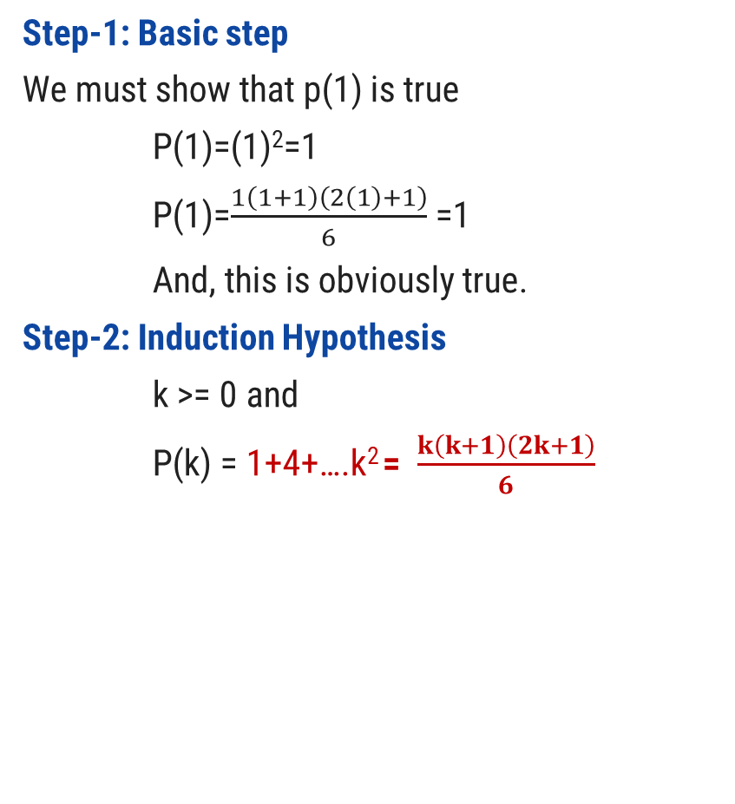
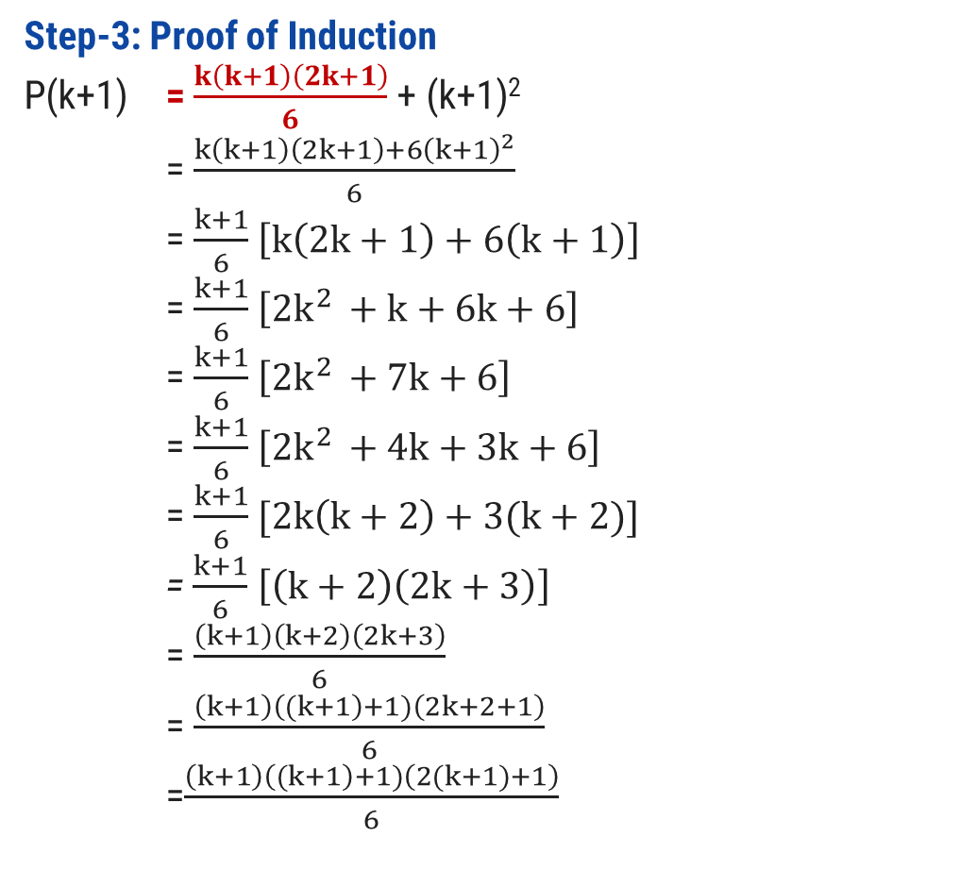
Prove $\sum_{i=1}^{n}{i^{2}=n(n+1)(2n+1)/6}$ using PMI
Step-1: Basic step
We must show that p(1) is true
P(1)=(1)²=1
P(1)=$\frac{1\left(1+1\right)\left(2\left(1\right)+1\right)}{6}$ =1
And, this is obviously true.
Step-2: Induction Hypothesis
k >= 0 and
P(k) = 1+4+….k² = $\frac{k\left(k+1\right)\left(2k+1\right)}{6}$
Step-3: Proof of Induction
P(k+1) = $\frac{k\left(k+1\right)\left(2k+1\right)}{6}$ + (k+1)²
= $\frac{k\left(k+1\right)\left(2k+1\right)+{6\left(k+1\right)}^{2}}{6}$
= $\frac{k+1}{6}$ $\left[k\left(2k+1\right)+6\left(k+1\right)\right]$
= $\frac{k+1}{6}$ $\left[{2k}^{2 }+k+6k+6\right]$
= $\frac{k+1}{6}$ $\left[{2k}^{2 }+7k+6\right]$
= $\frac{k+1}{6}$ $\left[{2k}^{2 }+4k+3k+6\right]$
= $\frac{k+1}{6}$ $[2k\left(k+2\right)+3(k+2)]$
= $\frac{k+1}{6}$ $\left[\left(k+2\right)\left(2k+3\right)\right]$
= $\frac{\left(k+1\right)\left(k+2\right)\left(2k+3\right)}{6}$
= $\frac{\left(k+1\right)\left((k+1\right)+1)\left(2k+2+1\right)}{6}$ =$\frac{\left(k+1\right)\left((k+1\right)+1)\left(2(k+1)+1\right)}{6}$
(Hence Proved)

Slide 60
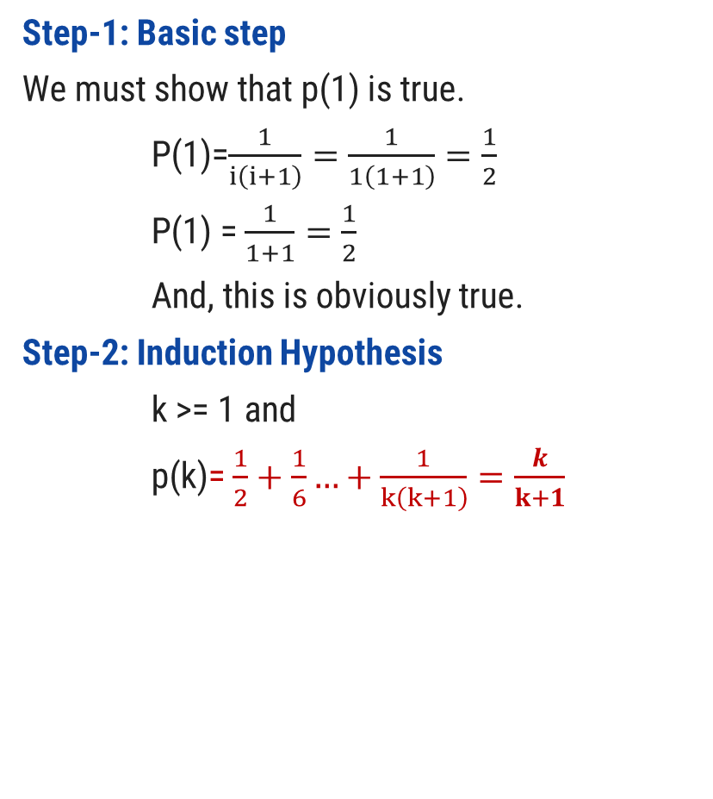
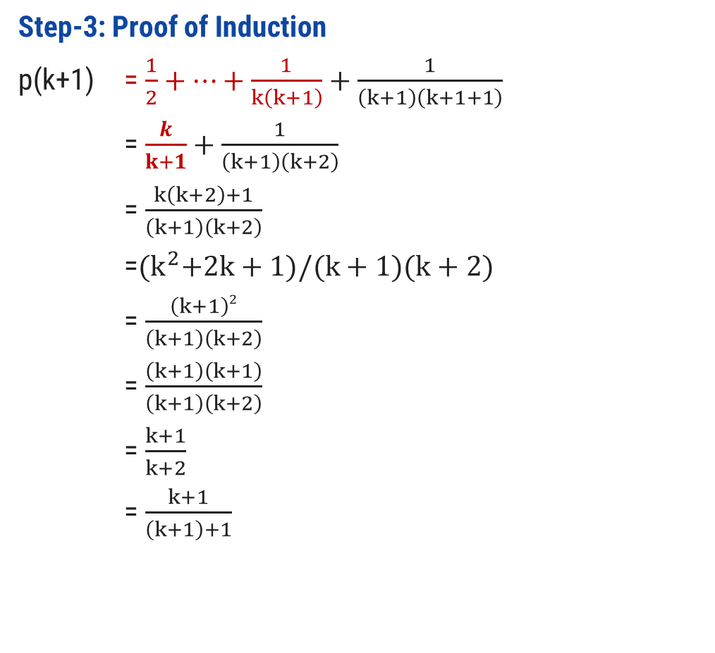
Prove $\sum_{i=1}^{n}{ \frac{1}{i(i+1)}}= \frac{n}{n+1}$ using PMI
Step-1: Basic step
We must show that p(1) is true.
P(1)=$\frac{1}{i\left(i+1\right)}=\frac{1}{1\left(1+1\right)}=\frac{1}{2}$
P(1) = $\frac{1}{1+1}=\frac{1}{2}$
And, this is obviously true.
Step-2: Induction Hypothesis
k >= 1 and
p(k)= $\frac{1}{2}+\frac{1}{6}…+\frac{1}{k\left(k+1\right)}=\frac{k}{k+1}$
Step-3: Proof of Induction
p(k+1) = $\frac{1}{2}+…+\frac{1}{k\left(k+1\right)}+\frac{1}{\left(k+1\right)\left(k+1+1\right)}$
= $\frac{k}{k+1}+\frac{1}{\left(k+1\right)\left(k+2\right)}$
= $\frac{k\left(k+2\right)+1}{\left(k+1\right)\left(k+2\right)}$
=${(k}^{2}+2k+1)/(k+1)(k+2)$
= $\frac{\left(k+1\right)2}{\left(k+1\right)\left(k+2\right)}$
= $\frac{\left(k+1\right)\left(k+1\right)}{\left(k+1\right)\left(k+2\right)}$
= $\frac{k+1}{k+2}$
= $\frac{k+1}{\left(k+1\right)+1}$
(Hence Proved)

Slide 61
Prove 1+ $\sum_{i=1}^{n}{i∗i!=\left(n+1\right)!}$ using PMI
Step-1: Basic step
We must show that p(1) is true.
P(1)= 1+(1*1!)=1+1=2
P(1)= (1+1)! =(2)! = 2
And, this is obviously true.
Step-2: Induction Hypothesis
k >= 1 and
p(k)= 1+(1+4..+(k*k!)) = (k+1)!
Step-3: Proof of Induction
P(k+1)= 1+(1+4..+(k*k!) + (k+1)*(k+1)!)
= (k+1)! + (k+1)(k+1)!)
= (k+1)! (1+(k+1))
= (k+1)! ((k+1)+1)
= ((k+1) + 1)!
(Hence Proved)
Note:
5!=5*4!
6!=6*5!
(K+1)!=(k+1)*k!

Slide 62
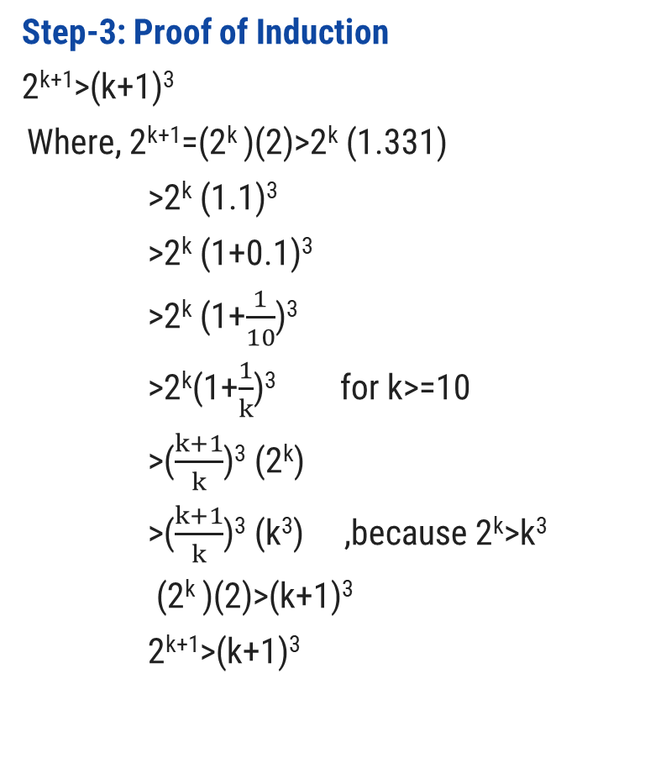
Prove that 2^{n}>n³ where n>=10, Using PMI
Step-1: Basic step
We must show that p(10) is true.
2¹⁰=1024 and 10³=1000
So,1024>1000
And, this is obviously true.
Step-2: Induction Hypothesis
For k>=10
P(k)= 2^{k}>k³
Step-3: Proof of Induction
2^{k+1}>(k+1)³
Where, 2^{k+1}=(2^{k} )(2)>2^{k} (1.331)
>2^{k} (1.1)³
>2^{k} (1+0.1)³
>2^{k} (1+$\frac{1}{10}$)³
>2^{k}(1+$\frac{1}{k}$)³ for k>=10
>($\frac{k+1}{k}$)³ (2^{k})
>($\frac{k+1}{k}$)³ (k³) ,because 2^{k}>k³
(2^{k} )(2)>(k+1)³
2^{k+1}>(k+1)³
(Hence Proved)

Slide 63
Prove n(n²+5) is divisible by 6 using PMI
Step-1: Basic step
We must show that p(1) is true.
P(1)=1(1²+5)=6
6 is divisible by 6
And, this is obviously true.
Step-2: Induction Hypothesis
For k>=1 and
P(k)=k(k²+5) is divisible by 6.
Step-3: Proof of Induction
(k+1)[(k+1)²+5]
= (k+1)(k²+2k+1+5)
= (k+1)(k²+2k+6)
=k³+2k²+6k+k²+2k+6
=k³+3k²+8k+6
=k³+3k²+5k+3k+6
=k(k²+5)+3k(k+1)+6
= k(k²+5)+3k(k+1)+6
Here, k(k²+5) is divisible by 6 ,given in induction hypothesis.
In Second term k and k+1 are consecutive. So, one number is even and one is odd. So, even number is always multiple of 2 and here 3 is also present .So, second term having (2*3) is also divisible by 6.
Last term 6 is obviously divisible by 6.Hence proved.

Slide 64
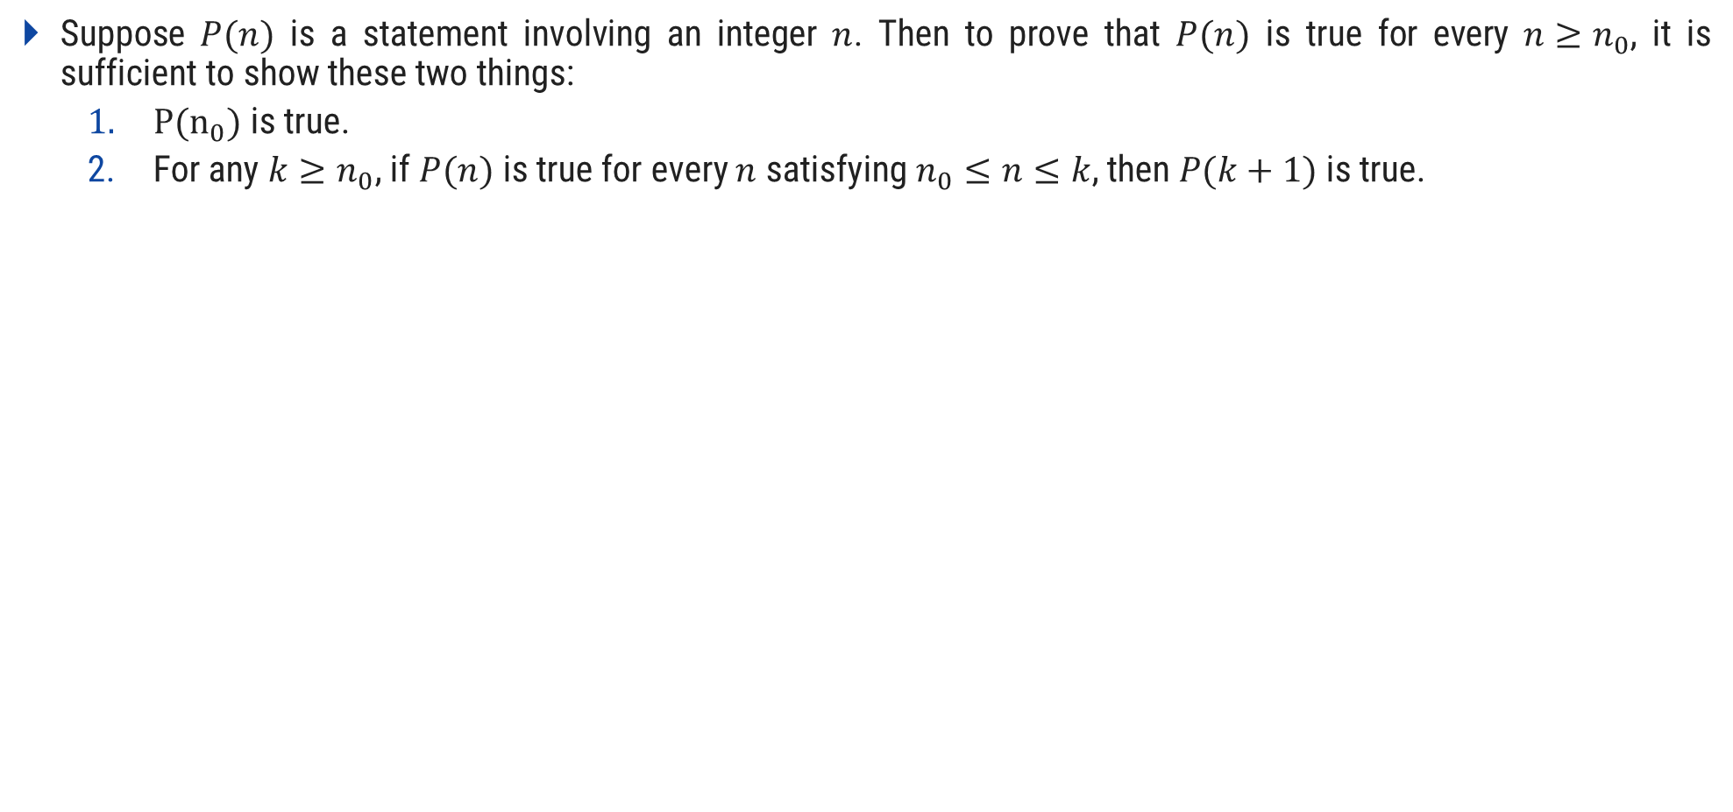
Strong Principle of Mathematical Induction
Suppose $P(n)$ is a statement involving an integer $n$. Then to prove that $P(n)$ is true for every $n≥n_{0}$, it is sufficient to show these two things:
$P(n_{0})$ is true.
For any $k≥n_{0}$, if $P(n)$ is true for every $n$ satisfying $n_{0}≤n≤k$, then $P(k+1)$ is true.

Slide 65
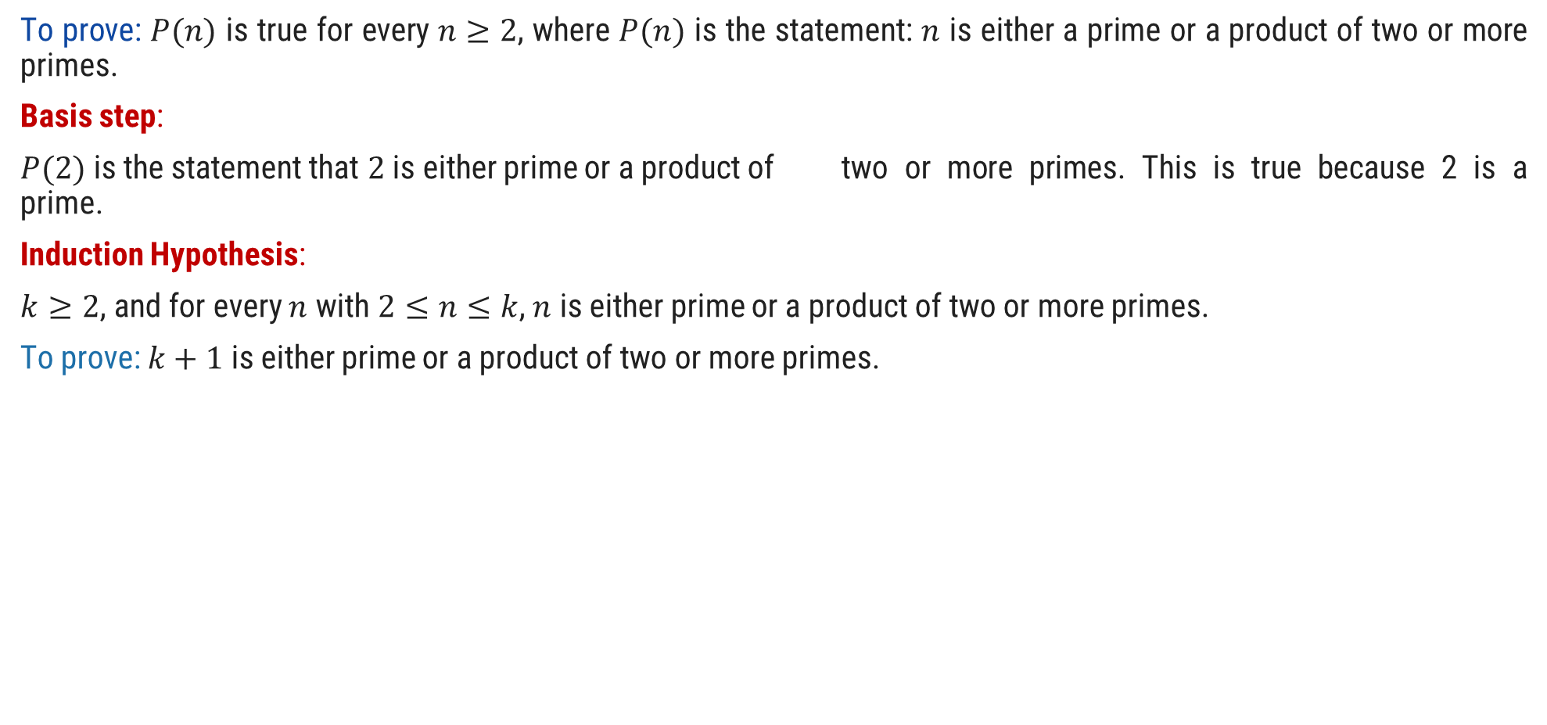
Prove that Integer Bigger than 2 have prime factorization using strong PMI
To prove: $P(n)$ is true for every $n≥2$, where $P(n)$ is the statement: $n$ is either a prime or a product of two or more primes.
Basis step:
$P(2)$ is the statement that $2$ is either prime or a product of two or more primes. This is true because 2 is a prime.
Induction Hypothesis:
$k≥2$, and for every $n$ with $2≤n≤k$, $n$ is either prime or a product of two or more primes.
To prove: $k+1$ is either prime or a product of two or more primes.
P(3)=3 Prime
P(4)=2*2 (Product of Primes)
P(5)=5 Prime
P(6)=3*2 (Product of Primes)
P(7)=7 Prime
P(8)=2*2*2 (Product of Primes)
P(9)=3*3 (Product of Primes)

Slide 66
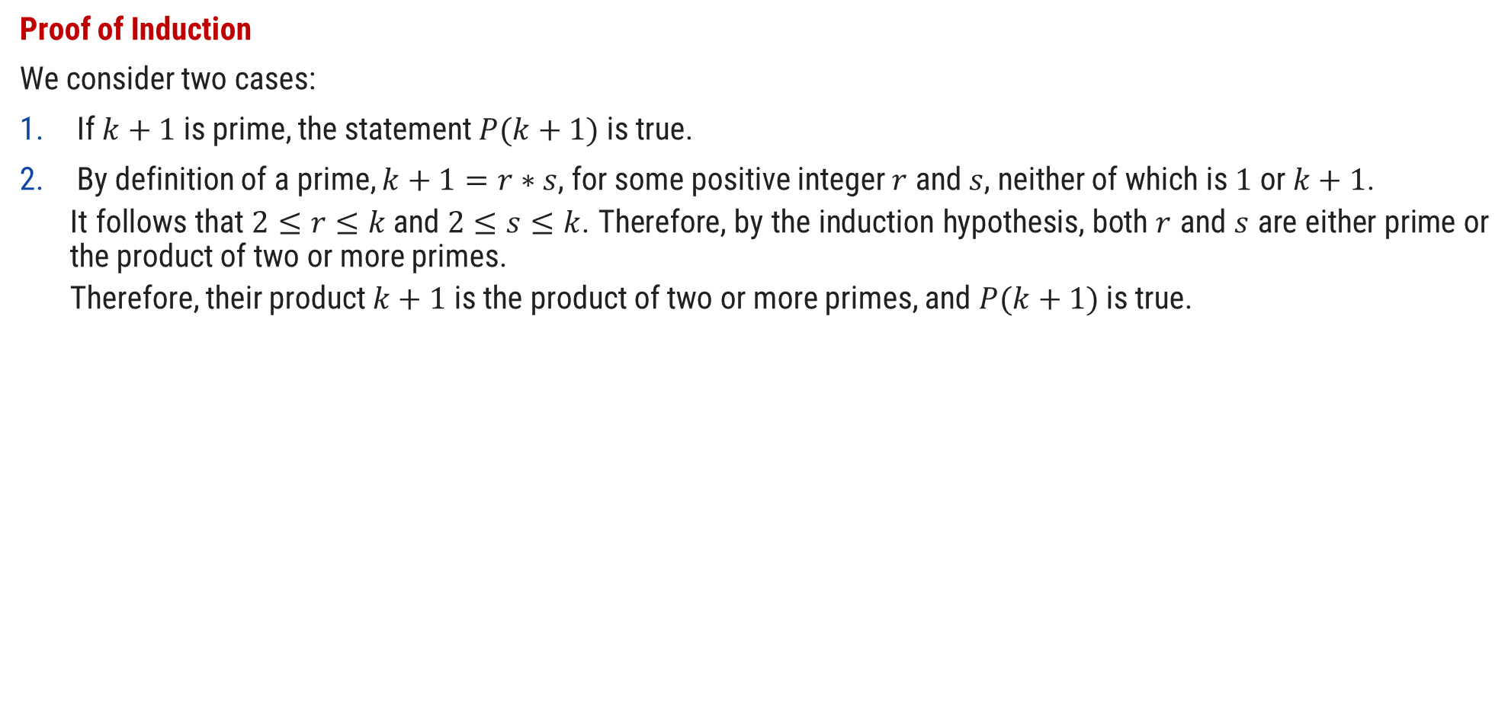
Prove that Integer Bigger than 2 have prime factorization using strong PMI
Proof of Induction
We consider two cases:
If $k+1$ is prime, the statement $P(k+1)$ is true.
By definition of a prime, $k+1=r∗s$, for some positive integer $r$ and $s$, neither of which is $1$ or $k+1$.
It follows that $2≤r≤k$and $2≤s≤k$. Therefore, by the induction hypothesis, both $r$ and $s$ are either prime or the product of two or more primes.
Therefore, their product $k+1$ is the product of two or more primes, and $P(k+1)$ is true.

Slide 67
Languages

Slide 68
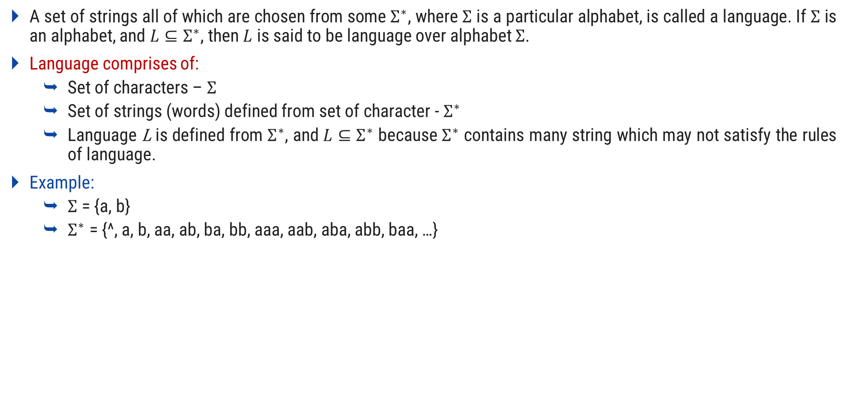
Language
A set of strings all of which are chosen from some $Σ^{∗}$, where $Σ$ is a particular alphabet, is called a language. If $Σ$ is an alphabet, and $L⊆Σ^{∗}$, then $L$ is said to be language over alphabet $Σ$.
Language comprises of:
Set of characters – $Σ$
Set of strings (words) defined from set of character - $Σ^{∗}$
Language L is defined from $Σ^{∗}$, and $L⊆Σ^{∗}$ because $Σ^{∗}$ contains many string which may not satisfy the rules of language.
Example:
$Σ$ = {a, b}
$Σ^{∗}$ = {^, a, b, aa, ab, ba, bb, aaa, aab, aba, abb, baa, …}

Slide 69

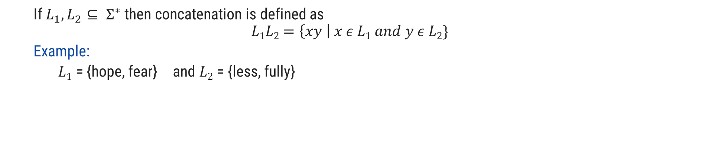
Operations over Language
Operations over the language are:
Concatenation
Union
* (Kleene closure)
+
If $L_{1}, L_{2}⊆ Σ^{∗}$ then concatenation is defined as
$$L1L2=\left\{xy \right| x ε L1 and y ε L2\}$$
Example:
$L1$ = {hope, fear} and $L2$ = {less, fully}
hopeless
$L1L2$ = {hopeless, hopefully, fearless, fearfully}

Slide 70

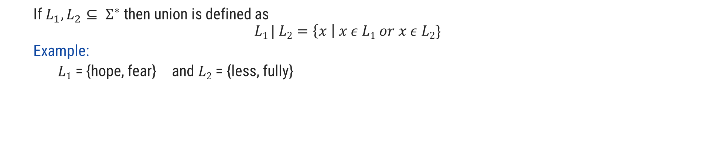
Operations over Language
Operations over the language are:
Concatenation
Union
* (Kleene closure)
+
If $L_{1}, L_{2}⊆ Σ^{∗}$ then union is defined as
$$L1 | L2=\left\{x \right| x ε L1 or x ε L2\}$$
Example:
$L1$ = {hope, fear} and $L2$ = {less, fully}
$L1 | L2$ = {hope, fear, less, fully}

Slide 71

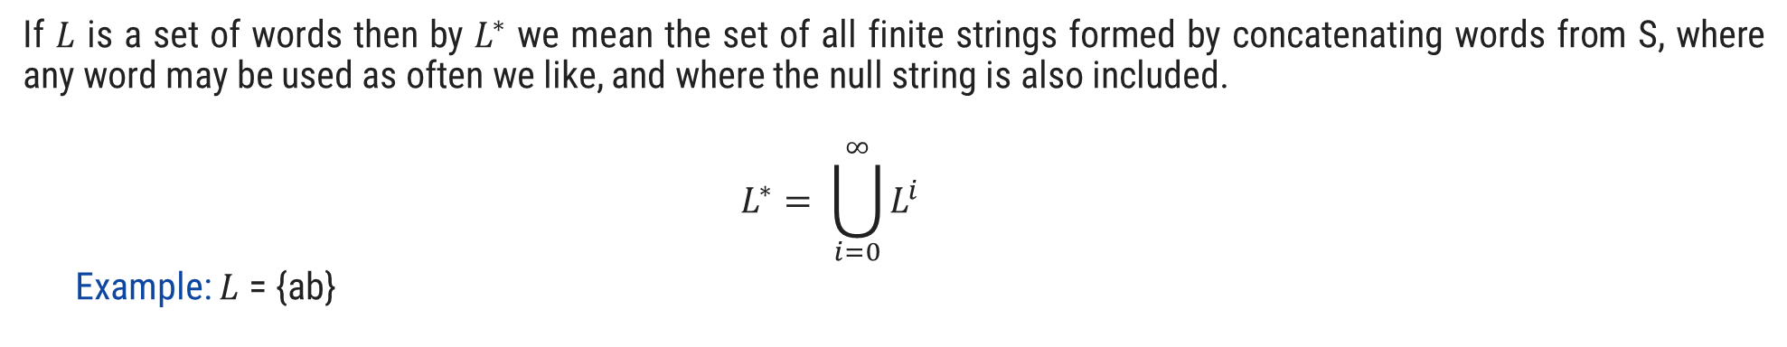
Operations over Language
Operations over the language are:
Concatenation
Union
* (Kleene closure)
+
If $L$ is a set of words then by $L^{∗}$ we mean the set of all finite strings formed by concatenating words from S, where any word may be used as often we like, and where the null string is also included.
$$L^{∗}= \bigcup_{i=0}^{∞}{L^{i}}$$
Example: $L$ = {ab}
$L$* = {^, ab, abab, ababab, abababab, ….}

Slide 72

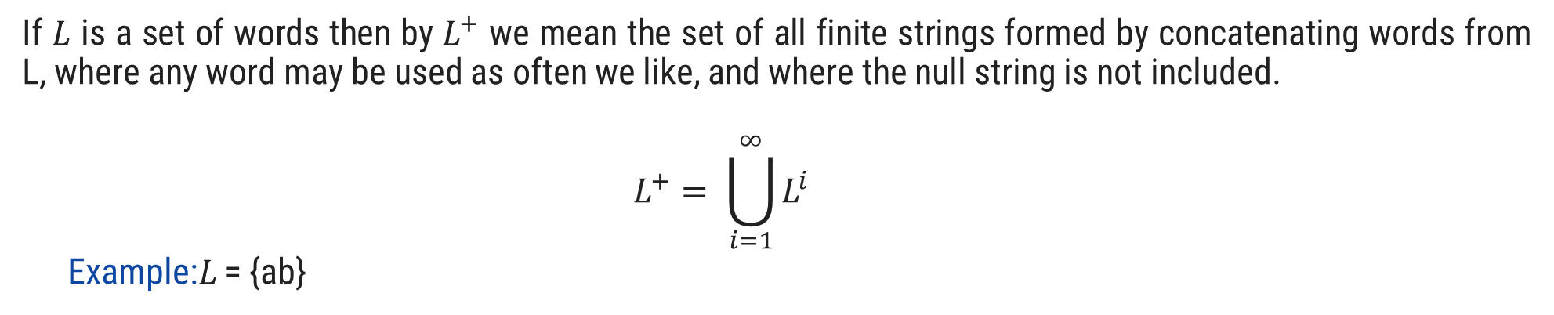
Operations over Language
Operations over the language are:
Concatenation
Union
* (Kleene closure)
+
If $L$ is a set of words then by $L^{+}$ we mean the set of all finite strings formed by concatenating words from L, where any word may be used as often we like, and where the null string is not included.
$$L^{+}= \bigcup_{i=1}^{∞}{L^{i}}$$
Example:$L$ = {ab}
$L^{+}$ = {ab, abab, ababab, abababab, ….}

Slide 73
Thank You

